Slide 2
Indicators of Inclusive Schools
Establishing inclusive values and principles
Establishing an inclusive learning environment
Promoting and supporting success
Organizing for inclusive instruction and learning
Engaging parents and community

Slide 3
Human Rights Placemat
AHRA
EA
CPC
CHRA

Slide 4
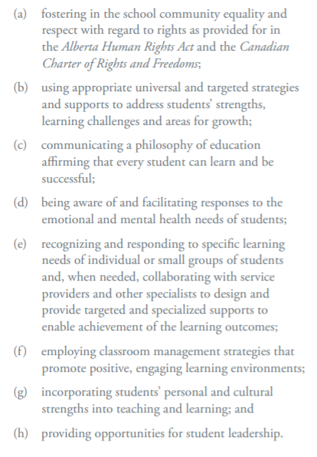

Inclusive Learning Environments
A teacher promotes and sustains inclusive learning environments where diversity is embraced and every student is welcomed, cared for, respected and safe

Slide 5
TQS Sentence Stems
I find it interesting that…
Something that surprised me…
I appreciate that…
I agree that…
Something that concerns me…
I wonder about…

Slide 6
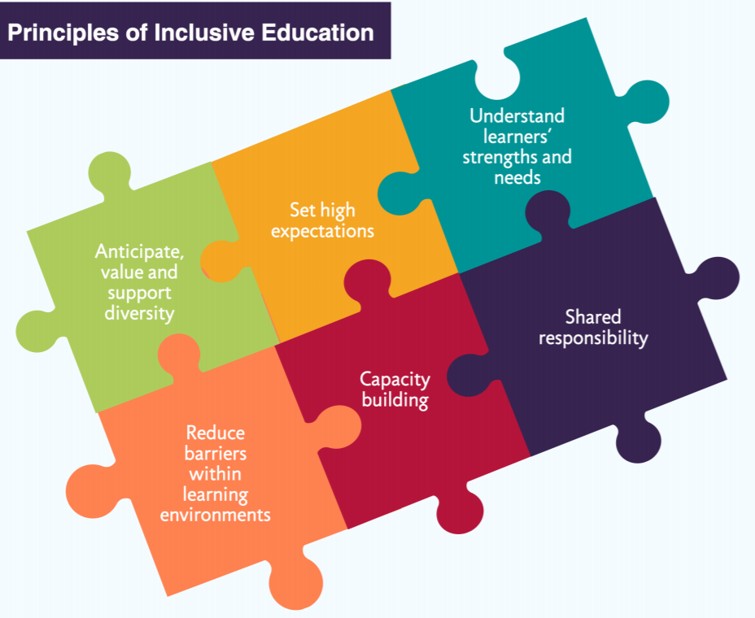
http://www.hpec.ab.ca/uploads/files/Inclusion%20Infograph.pdf

Slide 7
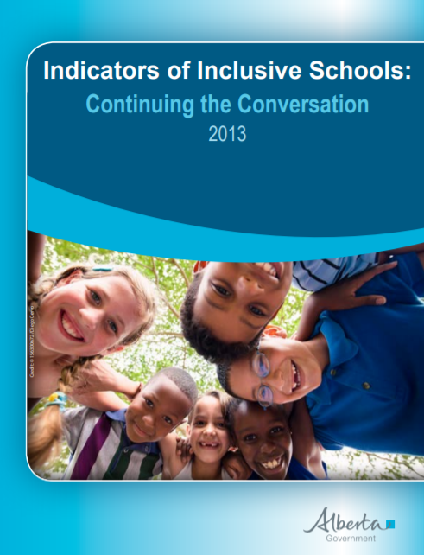
Five Dimensions – Indicators of Inclusive Schools
Establishing inclusive values and principles
Establishing inclusive learning environments
Providing supports for success
Organizing learning and instruction
Engaging with parents and community
https://education.alberta.ca/media/482253/indicators_of_inclusive_schools.pdf

Slide 8

Inclusive Learning Environment

Slide 9

Common Understanding?
Alberta Education defines inclusion as a way of thinking and acting that demonstrates universal acceptance and promotes a sense of belonging for all learners.
https://www.alberta.ca/inclusive-education.aspx?utm_source=redirector

Slide 10
“inclusive learning environment” means a classroom, school, on-line learning environment or other educational setting structured to anticipate, value and respond to the diverse strengths and needs of all students”

Slide 11
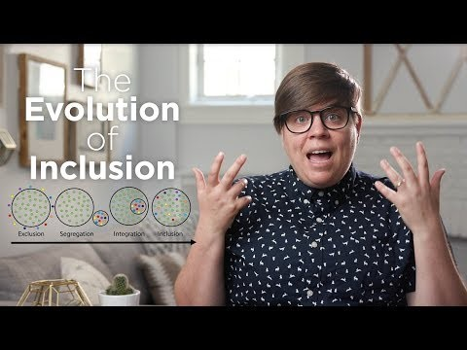
The Evolution of Inclusion
https://www.youtube.com/watch?v=PQgXBhPh5Zo

Slide 12
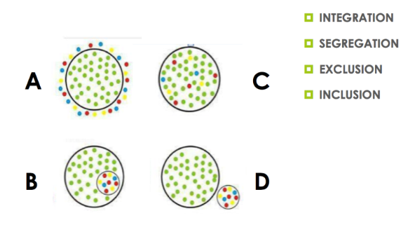
What is Inclusion?
https://blogsomemoore.com/

Slide 13
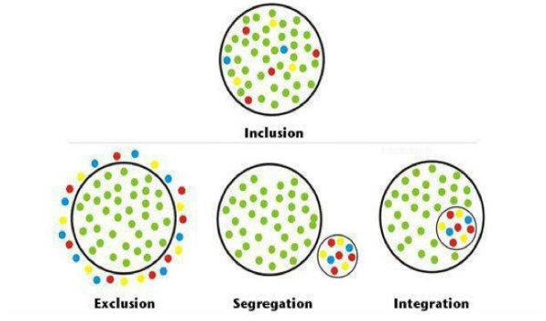
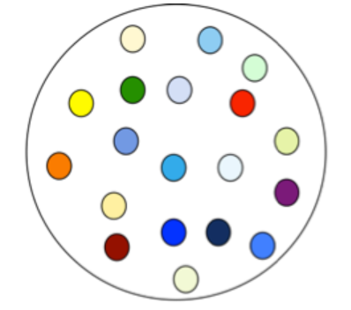
Inclusion and Individual Students
https://blogsomemoore.com/

Slide 14
Positive
Interesting
Challenging

Slide 15
Alberta Definition of Inclusion
Inclusion is a way of thinking and acting that demonstrates universal acceptance and promotes a sense of belonging for all learners.
https://www.alberta.ca/inclusive-education.aspx?utm_source=redirector

Slide 16
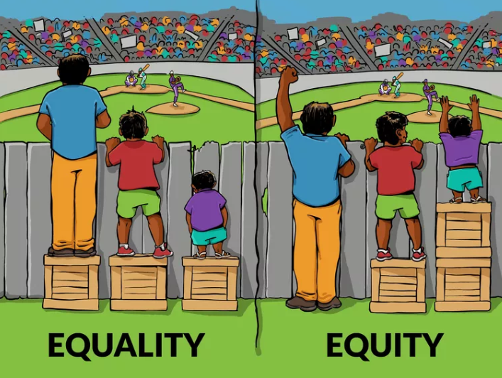
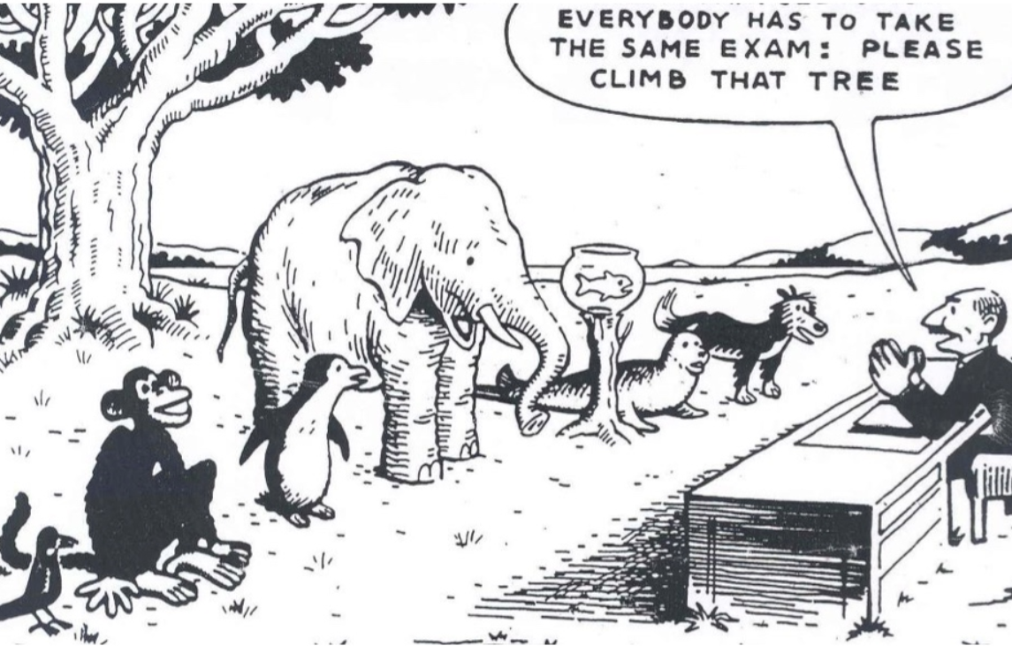
Equity vs. Equality
http://nccr-planets.ch/wp-content/uploads/2015/06/Bildschirmfoto-2015-06-03-um-16.27.33.jpg
http://interactioninstitute.org/illustrating-equality-vs-equity/

Slide 17
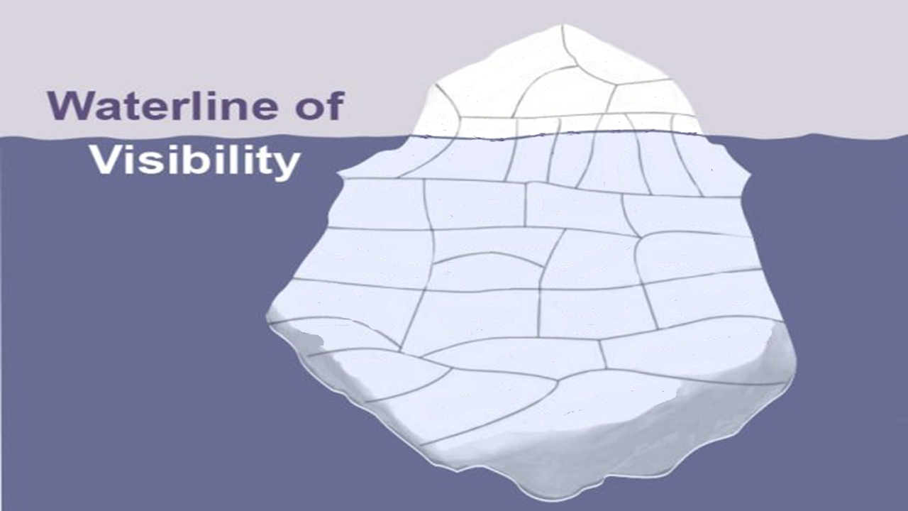
Diversity and Identity Iceberg
Adapted from Canadian Centre for Diversity and Inclusion

Slide 18
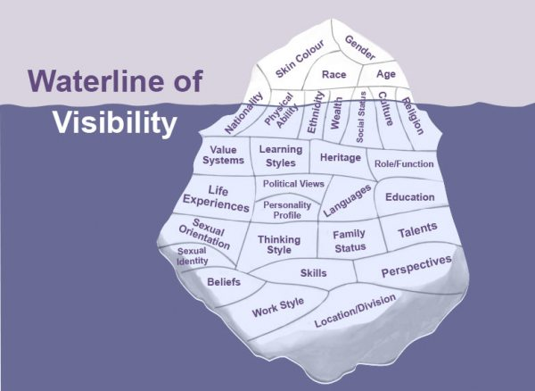
Diversity and Identity Iceberg Elements
Adapted from Canadian Centre for Diversity and Inclusion

Slide 19
Welcoming, Caring, Respectful and Safe Learning Environments
Alberta’s Education Act, Sec 33(1)(d) requires that each student enrolled in a school operated by the board and each staff member employed by the board is provided with a welcoming, caring, respectful and safe learning environment that respect diversity and fosters a sense of belonging.

Slide 20
Education Act, Sec 33 (2) states:
Each board shall establish, implement and maintain a policy respecting the board’s obligation to provide a welcoming, safe, respectful and safe learning environment that includes the establishment of a code of conduct for students that addresses bullying behaviour.

Slide 21
Bullying is:
A repeated and hostile or demeaning behaviour intended to cause harm, fear or distress, including psychological harm to harm a person’s reputation. It often involves an imbalance of social or physical power.

Slide 22
Bullying
What can teachers do?
Looks like
Sounds like
Where it happens
When it happens

Slide 23
Three-Pronged Approach to
Addressing Mental Health
Reduce stigma
Identify and intervene
Curriculum for mental health

Slide 24

Creating a Compassionate Classroom, Jigsaw
Pages 2 – 7
Pages 8 – 13
Pages 14 – 20
Pages 21 – 28
Pages 29 – 37

Slide 25

In closing, I’d like to say this about mental health…
The Last Word

Slide 26
Trauma-Informed Practice
What?
So What?
Now What?

Slide 27
Working Together to Support Mental Health in Alberta Schools
Page 9
Page 10
Page 11 + Reducing Stigma
Page 12 – 13 Positive Respectful Language

Slide 28
Best Practices to Respect
LGBTQ Human Rights
Start
Continue
Stop

Slide 29

Group Mind Map

Slide 30
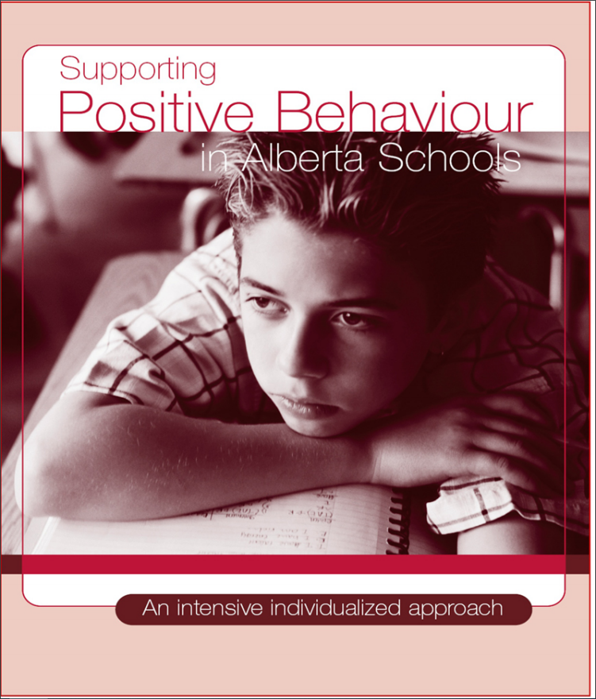
https://education.alberta.ca/media/464616/supporting_positive_behaviour_individual.pdf

Slide 31
Classroom Management
Ineffective | Effective

Slide 32
Response to Intervention (RTI)
Positive
Interesting
Challenging

Slide 33
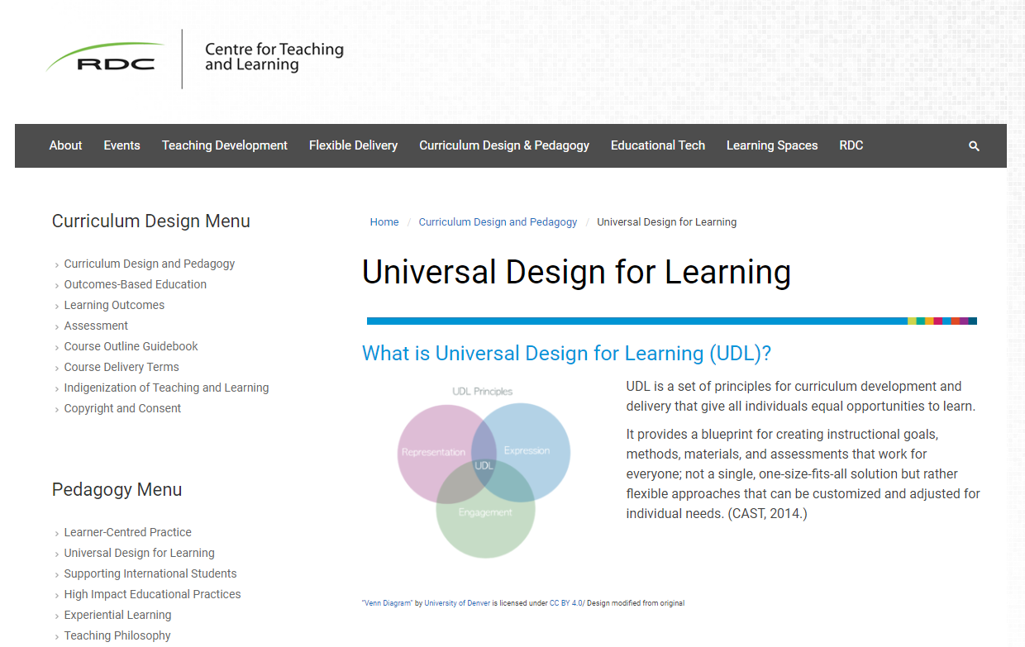
“Universal Design for Learning.” Centre for Teaching and Learning, Red Deer College
http://ctlrdc.ca/curriculum-design-pedagogy/universal-design-for-learning/

Slide 34
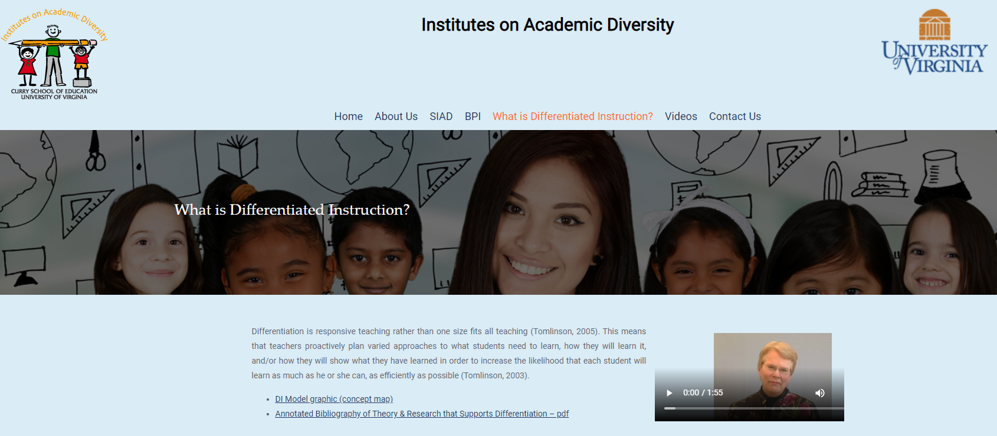
DifferentiationCentral
University of Virginia
http://differentiationcentral.com/what-is-differentiated-instruction/

Slide 35
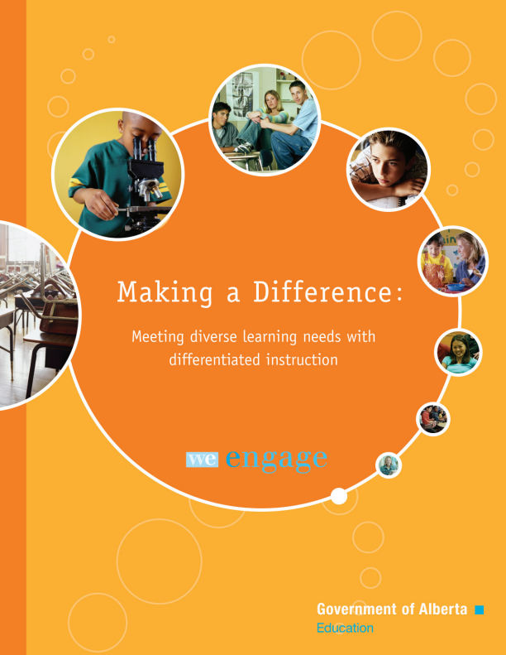
Making a Difference
Alberta Education (2010)
https://education.alberta.ca/media/384968/makingadifference_2010.pdf

Slide 36

Inclusive Education Library
http://www.learnalberta.ca/content/ieptlibrary/

Slide 37
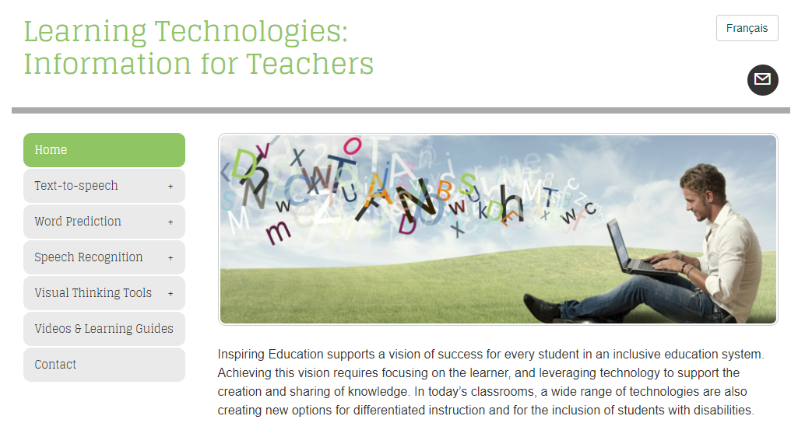
www.learningtechnologiesab.com

Slide 38
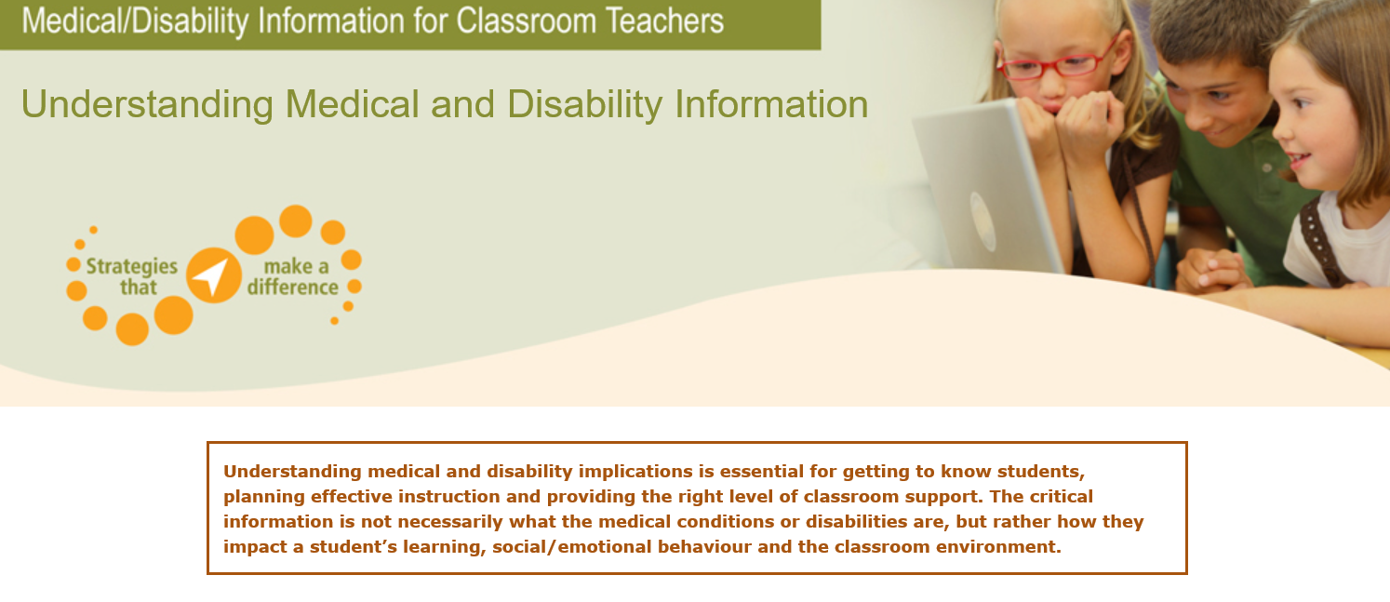
https://www.learnalberta.ca/content/inmdict/html/index.html

Slide 39
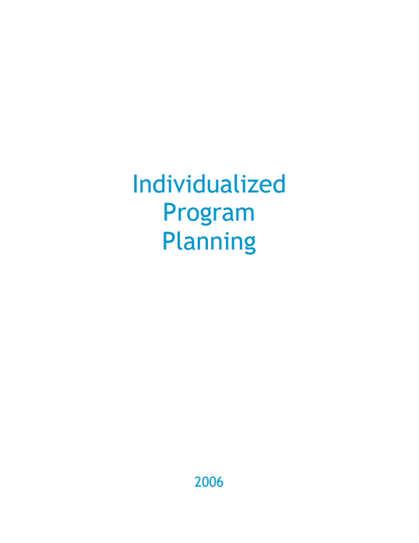
Individualized Program Planning
Alberta Education (2006)
https://education.alberta.ca/media/384992/indidivualized-program-planning-2006.pdf

Slide 40
Individualized Program Planning Jigsaw
Everyone reads Chapter 1
Read your assigned chapter
Prepare an overview of this chapter
Present the overview of your assigned chapter

Slide 41
Gifted and Talented
Giftedness is exceptional potential and/or performance across a wide range of abilities in one or more areas:
General intellect
Specific academia
Creative thinking
Social
Music
Art
Kinesthesia
Each school authority establishes its own assessment process for identifying giftedness and ensuring appropriate programming.
Special Education Coding Criteria, 2019/20

Slide 42
Alberta Education student statistics for 2017/18 report 6,752 students K-12, or 0.9% of the Alberta student population were coded as gifted and talented.
Source: https://www.alberta.ca/student-population-statistics.aspx

Slide 43
Design the Future
Dream
Define Positive
Appreciative
Inquiry
Conversation

Slide 44

https://education.alberta.ca/media/464613/the-journey-a-handbook-for-parents-2004.pdf
The Journey
Alberta Education (2004)

Slide 45
Diverse Learning Needs
Autism Spectrum Disorder
Blind or Visually Impaired
Deaf or Hard of Hearing
Attention Deficit / Hyperactivity
Fetal Alcohol Spectrum Disorder
Learning Disabilities
Gifted
Positive Behaviour Supports

Slide 46
Pair and Share
Definition of the learning need
Three instructional strategies
Something that surprised you or that you would like learn more about

Slide 47
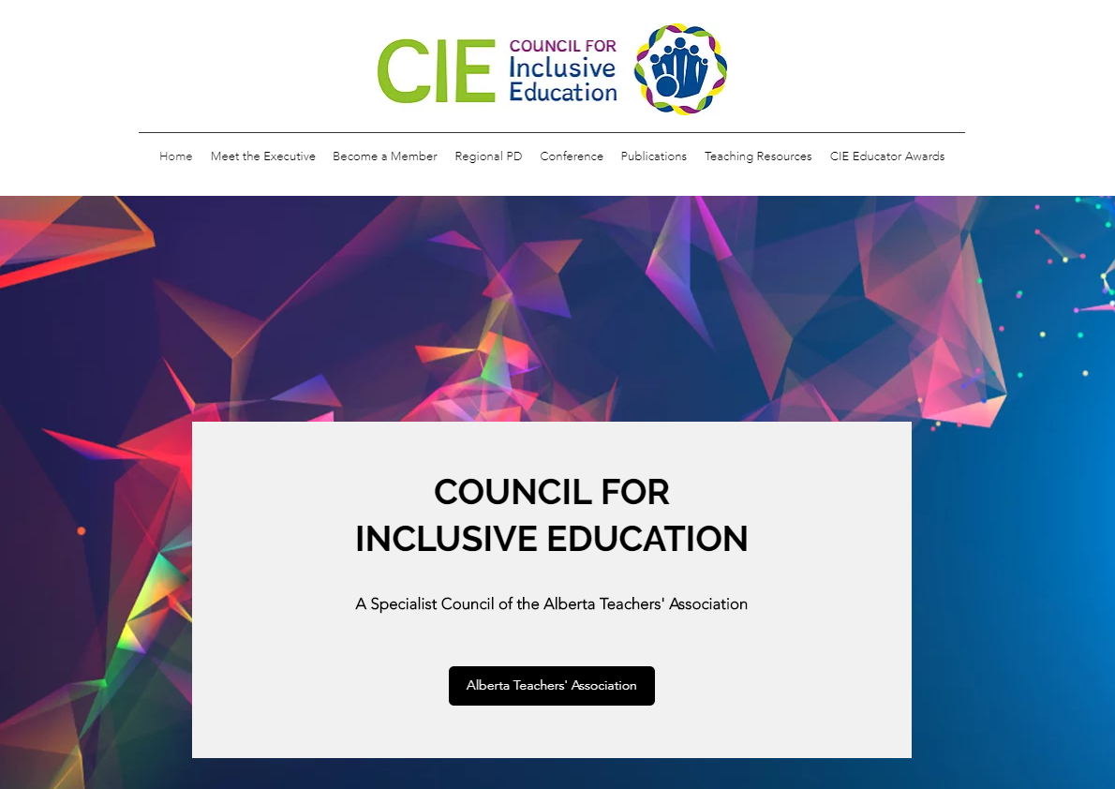
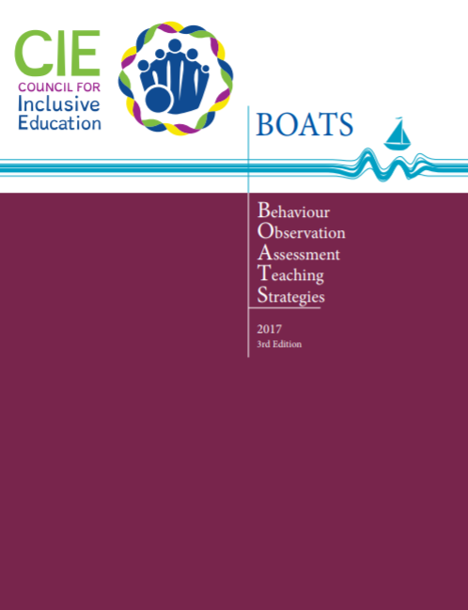
Council for Inclusive Education
https://www.cieducation.ca/

Slide 48
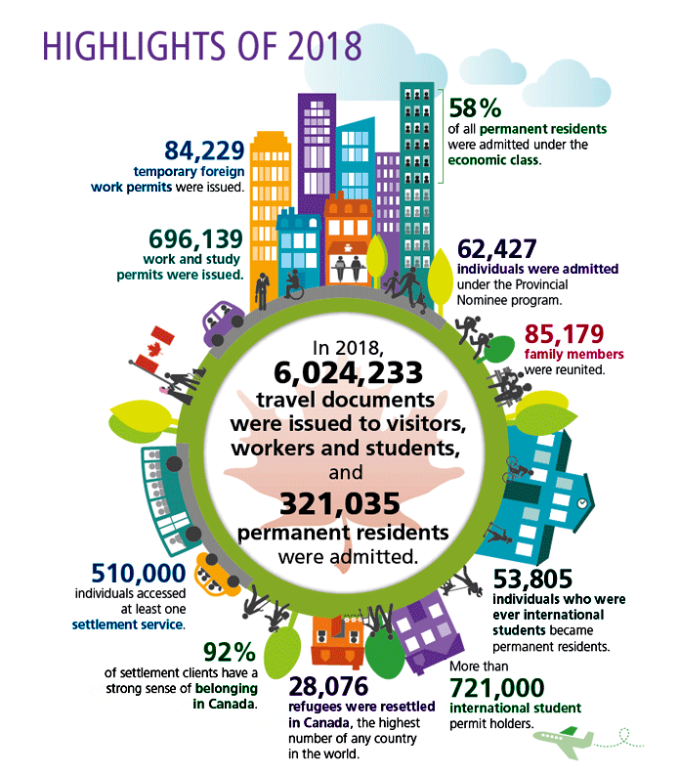
https://www.canada.ca/en/immigration-refugees-citizenship/corporate/publications-manuals/annual-report-parliament-immigration-2019.html

Slide 49
Education Act (2020)
Section 32: Parent responsibilities
A parent has the prior right to choose the kind of education that shall be provided to the parent’s child, and as a partner in education, has the responsibility to
(a) act as the primary guide and decision-maker with respect to the child’s education
(e) co-operate and collaborate with school staff to support the delivery of supports and services to the child

Slide 50
Know
Want to Know
Learned

Slide 51
Key concepts about diversity
  We all have diverse talents, skills and experiences.
  Canada is a diverse country. This diversity brings numerous challenges and assets to our society.
  Diversity is a fact. Inclusion is a choice/action.
  We all have complex identities, consisting of visible and invisible components.

Slide 52

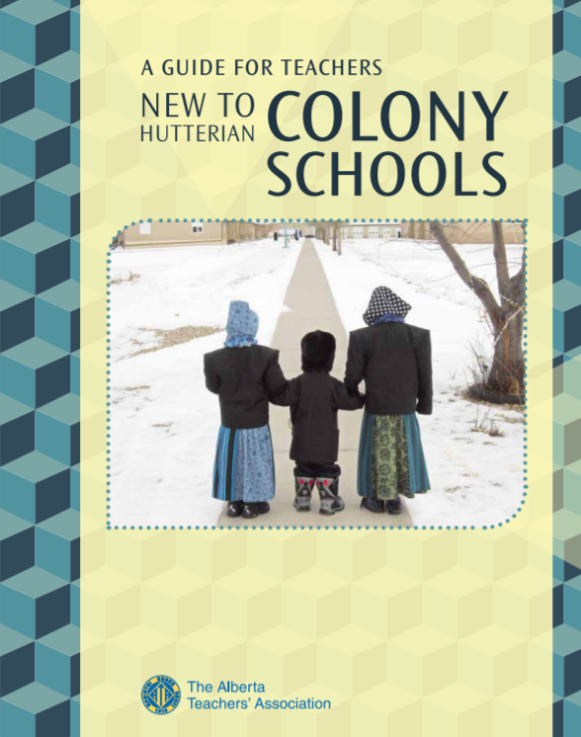

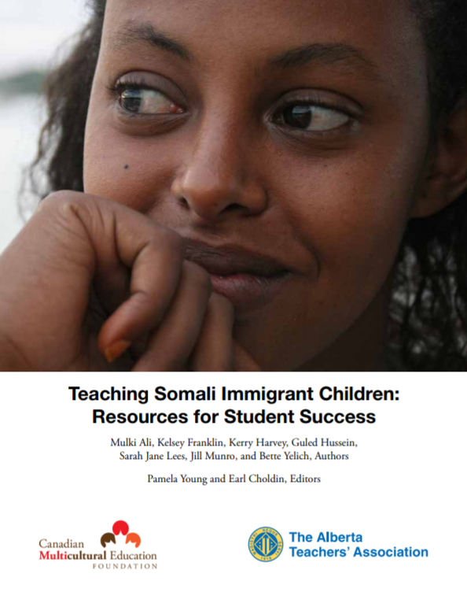
Diversity, Equity and Human Rights
https://www.teachers.ab.ca/For%20Members/Professional%20Development/Diversity-Equity-and-Human-Rights/Pages/Index.aspx

Slide 53



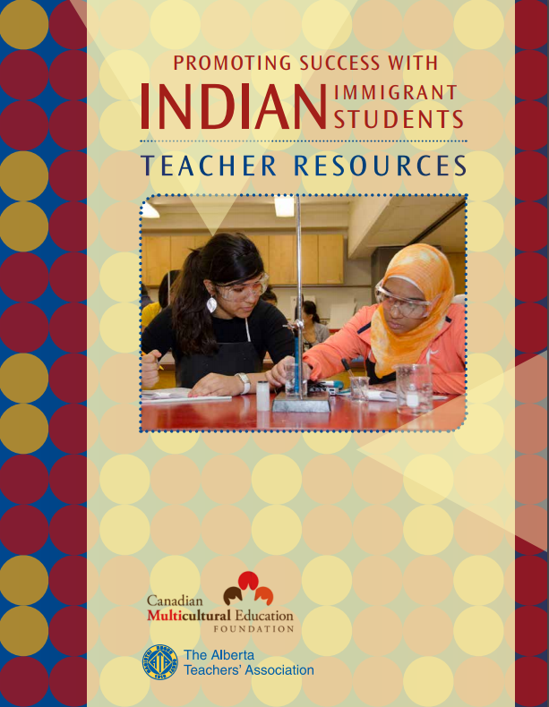

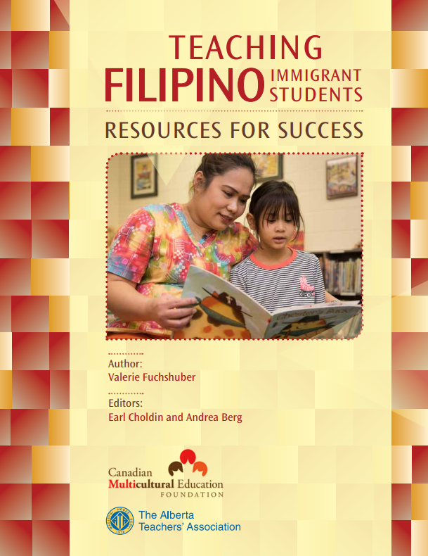
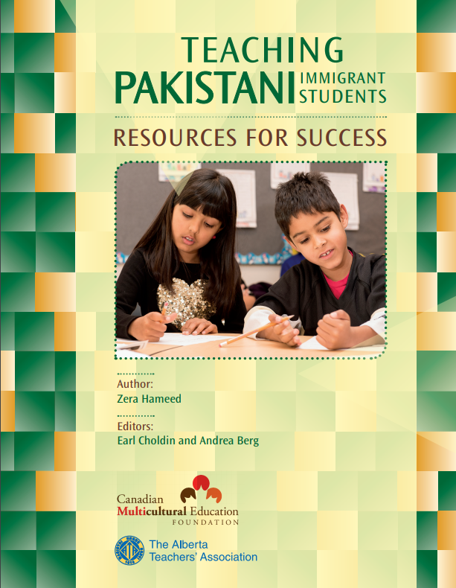
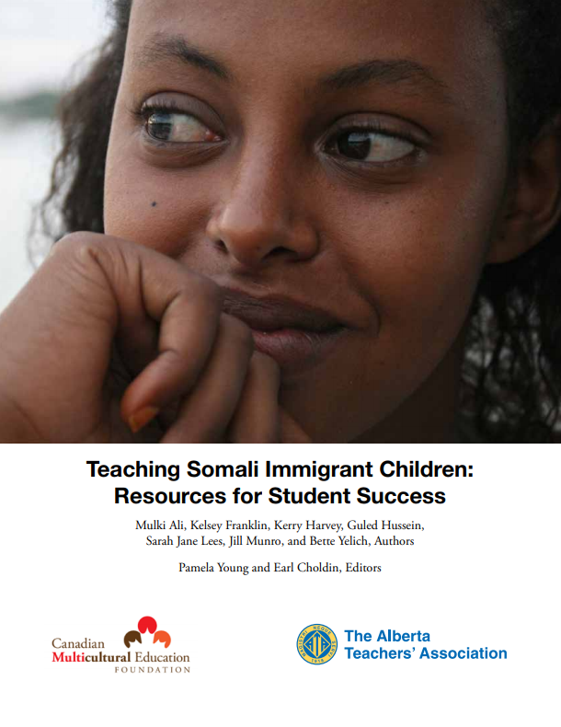
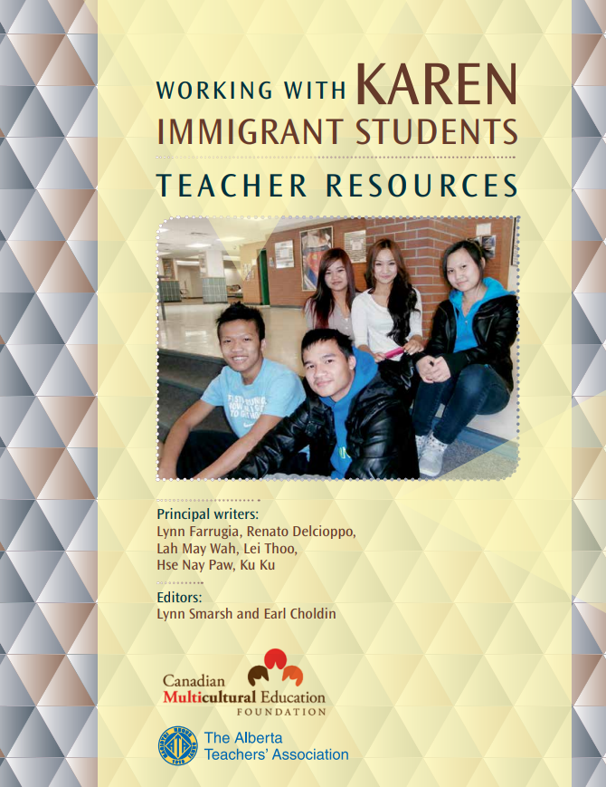
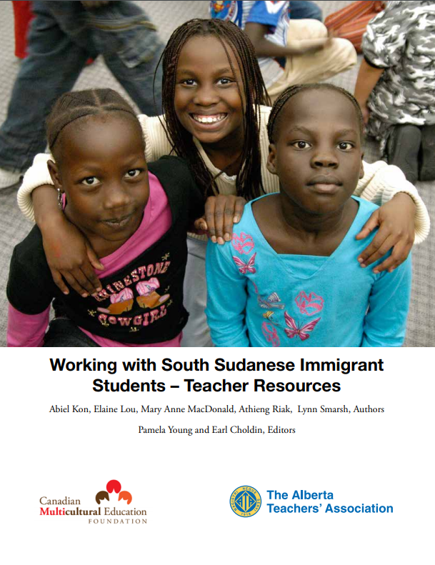
Diversity, Equity and Human Rights
https://www.teachers.ab.ca/For%20Members/Professional%20Development/Diversity-Equity-and-Human-Rights/Resources/Pages/Resources.aspx

Slide 54
Intercultural Education
Incorporating student’s personal and cultural strengths into teaching and learning
What | So What | Now What

Slide 55

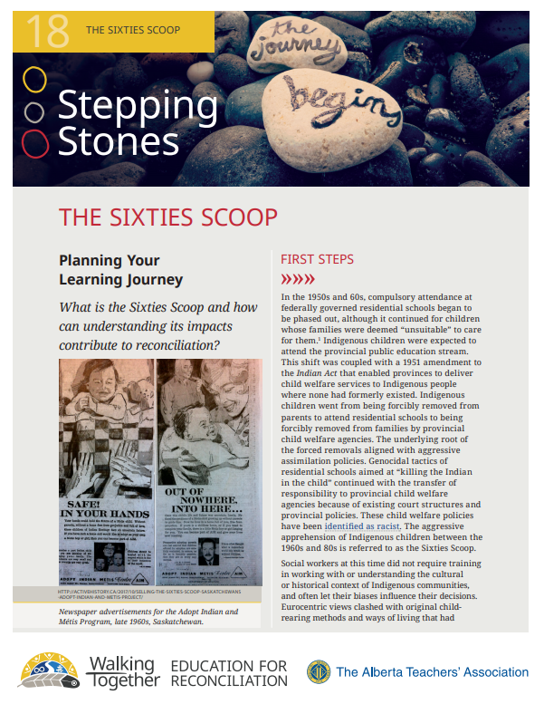
Indigenous Education and Walking Together, ATA
https://www.teachers.ab.ca/For%20Members/Professional%20Development/IndigenousEducationandWalkingTogether/Pages/WalkingTogether.aspx

Slide 56

Our Words, Our Ways. Alberta Education (2005)
https://education.alberta.ca/media/3615876/our-words-our-ways.pdf

Slide 57
Student Mentoring
Know | Want to Know | Learned

Slide 58

Jigsaw Assignments
Pages 12 – 15
Pages 17 – 20
Pages 30 – 35
Pages 42 – 45

Slide 59
Service Learning
Service learning refers to learning that actively involves students in a wide range of experiences, which often benefit others and the community, while also advancing the goals of a given curriculum.

Slide 60
“Never doubt that a small group of thoughtful committed people can change the world.
Indeed it is the only thing that ever has.”
–Margaret Mead

