Slide 1
Professional Learning Pebbles:
Activities to Build Educators’ Foundational Knowledge

Slide 2
Treaty 6 Acknowledgement
The Alberta Teachers’ Association acknowledges Treaty 6 territory—the ancestral and traditional territory of the Cree, Dene, Blackfoot, Saulteaux, Nakota Sioux, as well as the Métis. We acknowledge the many First Nations, Métis and Inuit whose footsteps have marked these lands for generations. We are grateful for the traditional Knowledge Keepers and Elders who are still with us today and those who have gone before us. We recognize the land as an act of reconciliation and gratitude to those whose territory we reside on or are visiting.

Slide 3
The Alberta Teachers’ Association acknowledges Treaty 7 territory—the ancestral and traditional territory of the Blackfoot Confederacy: Kainai, Piikani and Siksika as well as the Tsuu T’ina First Nation and Stoney Nakoda First Nation. We acknowledge the many First Nations, Métis and Inuit whose footsteps have marked these lands for generations. We are grateful for the traditional Knowledge Keepers and Elders who are still with us today and those who have gone before us. We recognize the land as an act of reconciliation and gratitude to those whose territory we reside on or are visiting.
Treaty 7 Acknowledgement

Slide 4
The Alberta Teachers’ Association acknowledges Treaty 8 territory—the ancestral and traditional territory of the Cree, Dene, as well as the Métis. We acknowledge the many First Nations, Métis and Inuit whose footsteps have marked these lands for generations. We are grateful for the traditional Knowledge Keepers and Elders who are still with us today and those who have gone before us. We recognize the land as an act of reconciliation and gratitude to those whose territory we reside on or are visiting.
Treaty 8 Acknowledgement

Slide 5
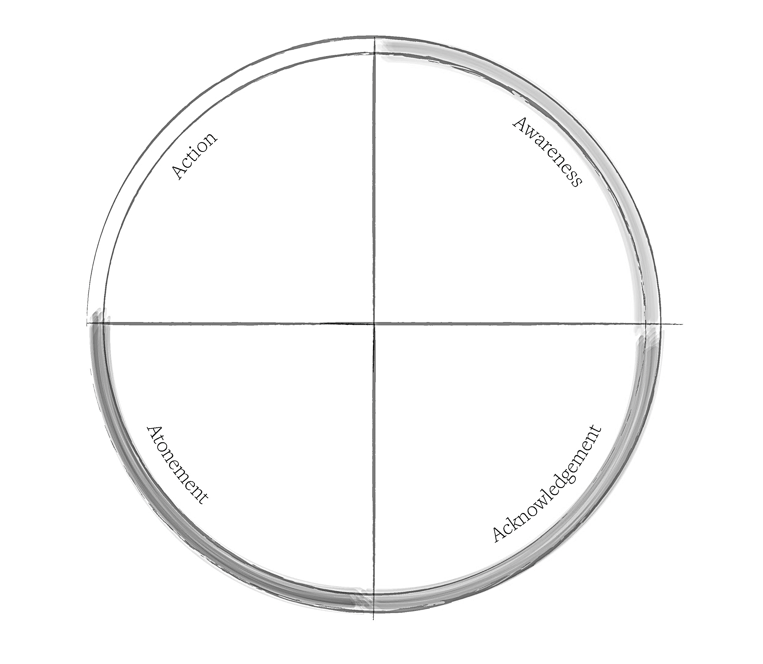
In order for reconciliation to happen, there has to be:
action to change behaviour
awareness of the past
atonement for
the causes
acknowledgment of the harm
(Honouring the Truth, Reconciling for the Future:Summary of the Final
Report of the Truth and Reconciliation Commission of Canada)
Notes:
4 As= structure of all of our workshops

Slide 6
Workshop Outcomes
Examine some laws that have been enacted by the Canadian government in relation to First Nations, Métis and Inuit in Canada (awareness).
Explore the concept of assimilation and how it has shaped government policy towards Indigenous people in Canada (acknowledgment).
Engage in conversation about contemporary contexts of many First Nations, Métis and Inuit (atonement).
Develop an understanding of reconciliation and the role educators play in the reconciliation process (action).

Slide 7
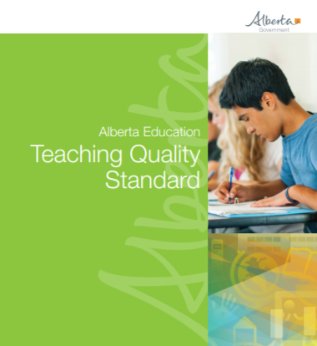
TQS Scavenger Hunt
https://education.alberta.ca/media/3739620/standardsdoc-tqs-_fa-web-2018-01-17.pdf

Slide 8
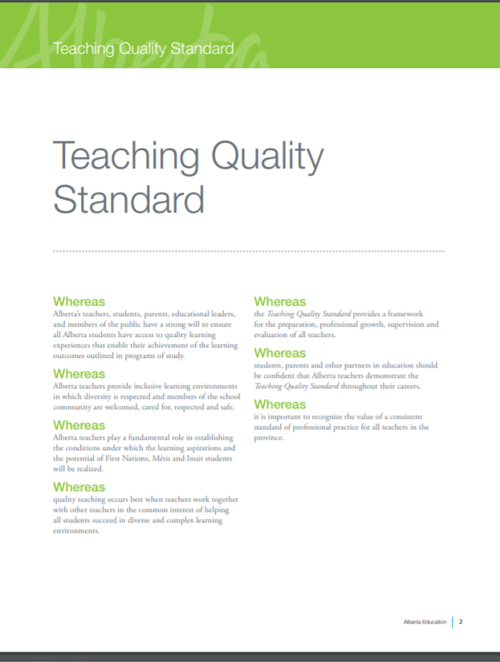
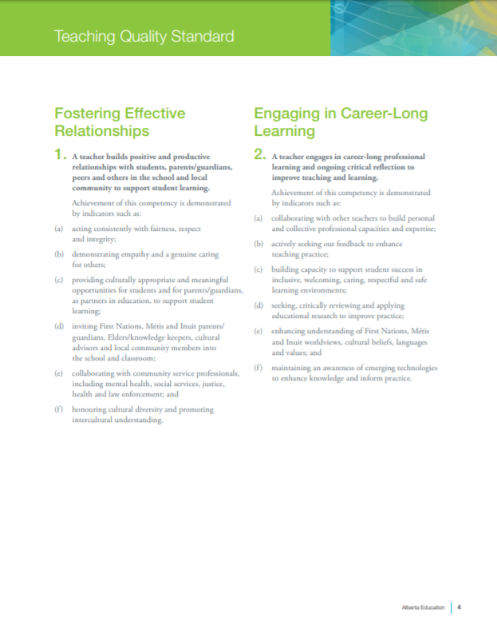
TQS Scavenger Hunt
How many times does the term “First Nations, Métis and Inuit” appear in the document?
8 times
Page 2
Page 4
Page 6

Slide 9
TQS Scavenger Hunt
2. Competency 5 is focused on applying foundational knowledge about First Nations, Métis and Inuit. There are two other competencies that also have indicators focused on First Nations, Métis and Inuit; what are they?
1(d) and 2(e)
Notes:
2. 1(d) and 2(e)

Slide 10
TQS Scavenger Hunt
for the benefit of all students
What are the last six words of Competency 5?
Indicator (a) under Competency 5 outlines three specific topics; what are they?
treaties and agreements with First Nations;
legislation and agreements negotiated with Métis;
residential schools and their legacy
Indicator (c) under Competency 5 suggests “using the program of studies” to provide opportunities for all students to develop knowledge and understanding of, and respect for, the histories, cultures, languages, contributions, perspectives, experiences and contemporary contexts of First Nations, Métis and Inuit.
Indicator (d) states that it supports the learning experiences of who?
treaties and agreements with First Nations;
legislation and agreements negotiated with Métis;
residential schools and their legacy
program of studies
all students

Slide 11
My Learning Journey
5. (a) understanding the historical, social, economic, and political implications of treaties and agreements with First Nations;
5. (d) supporting the learning experiences of all students by using resources that accurately reflect and demonstrate the strength and diversity of First Nations, Métis and Inuit.
5. (a) understanding the historical, social, economic, and political implications of legislation and agreements negotiated with Métis;
5. (c) using the programs of study to provide opportunities for all students to develop a knowledge and understanding of, and respect for, the histories, cultures, languages, contributions, perspectives, experiences and contemporary contexts of First Nations, Métis and Inuit;
5. (b) supporting student achievement by engaging in collaborative, whole school approaches to capacity building in First Nations, Métis and Inuit education;
Proficient
Progressing
Advancing
Beginning

Slide 12
Awareness

Slide 13
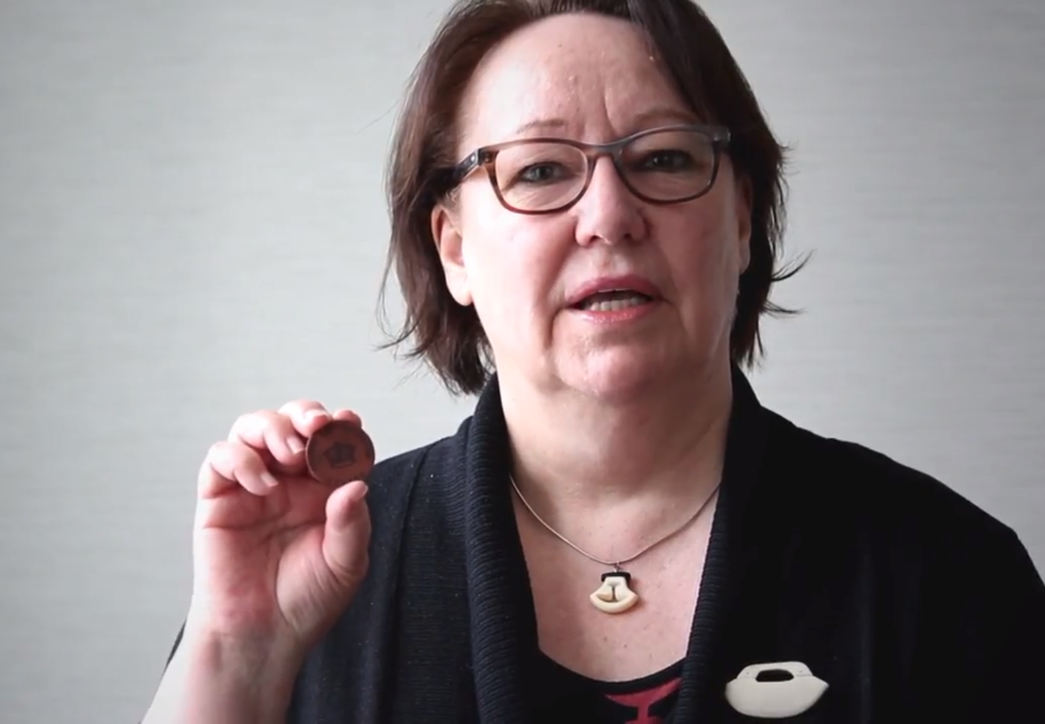
Laws and Reports
Sheila Watt-Cloutier Here’s My Canada
https://youtu.be/w-b373nCHlk

Slide 14
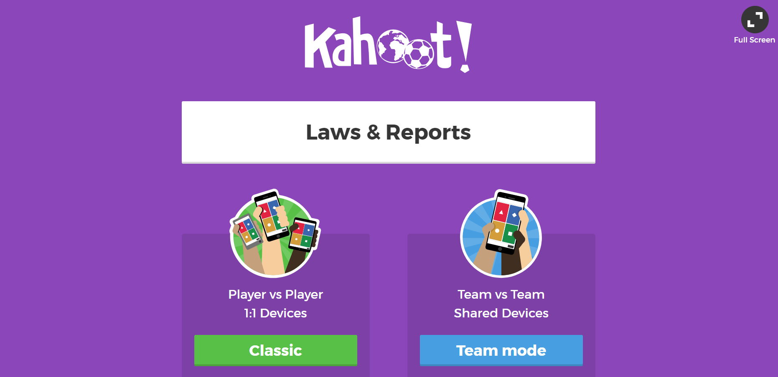
Laws and Reports

Slide 15
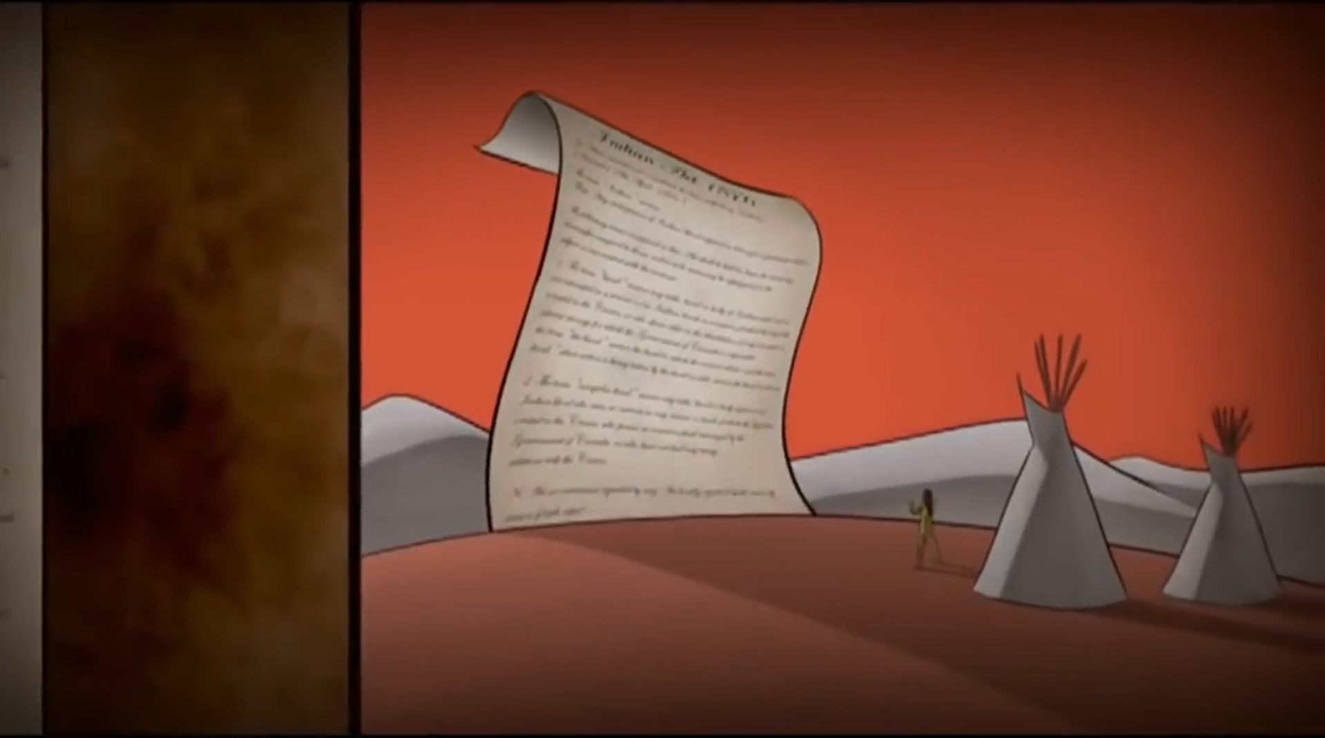
Indian Act True/False
https://youtu.be/ELUs4pM_xUY
Notes:
The 8th Fire (12:00-13:10)
Do not reveal the next slide until the Indian Act true/false activity has been completed

Slide 16
Indian Act True/False
1. Imposed the elected chief and band council system. | 2. Prohibited marriage ceremonies off reserve. | 3. Denied women status. | 4. Could expropriate portions of reserves.
5. Placed the names of individuals living on reserve on a list called the Reserve Roster. | 6. Renamed individuals with European names. | 7. Created a permit system to control Indians’ ability to sell products from farms. | 8. Prohibited reserves from amalgamating or dividing.
9. Prohibited the sale of intoxicants to Indians. | 10. Included laws for Inuit and Métis people. | 11. Declared potlatch and other cultural ceremonies illegal. | 12. Restricted Indians from leaving their reserve without permission from an Indian agent.
13. Guaranteed postsecondary funding after leaving residential schools. | 14. Created the Indian Residential School system. | 15. Forbade western Indians from appearing in any public dance, show, exhibition, stampede, or pageant wearing traditional regalia. | 16. Prohibited Indians from adopting children; if they did, they became enfranchised.
17. Forbade Indians from forming political organizations. | 18. Forbade Indian students from speaking their language or practicing their spirituality. | 19. Exempted Indians from paying taxes on and off reserve. | 20. Denied Indians the right to vote.

Slide 17
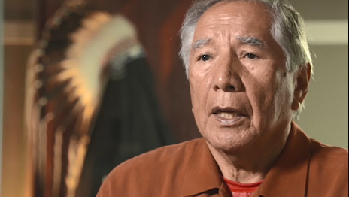
Avoid the Acronym
Leroy Little Bear: Terminology
www.lieutenantgovernor.ab.ca/AOE_Legacy/Member/161/Video

Slide 18
Avoid the Acronym
ABORIGINAL PEOPLES OF CANADA | The First Peoples in Canada and their descendants. Includes First Nations, Métis and Inuit peoples. Each group is distinct and has its own history, culture, Protocols, Traditions and languages. Usually used as a term in government policy. Term used in the Constitution.
CEREMONIALIST | A highly respected member of a First Nation or Métis community. Recognized and identified by members of the community as being knowledgeable about spirituality and spiritual practices.
ELDER | A highly respected member of a First Nation, Métis or Inuit community. Recognized and identified by members of the community as carrying important wisdom, Oral Traditions and knowledge of their culture. Shares his/her understandings through Teachings, Ceremonies, Stories and/or Songs. Individuals hold different gifts or talents. Their role and the appropriate Protocols for approaching them varies from community to community. They do not have to be a senior citizen; the carrying of knowledge and recognition by the community are the key factors in determining who they are.
BILL C-31 INDIAN | A person who gained or regained Indian status because of the Act to Amend the Indian Act, 1985. Status Indian women lost their status, band membership and all associated rights when they married non-status men prior to Bill C-31. Although gains were made with Bill C-31, challenges remain.

Slide 19
Avoid the Acronym
FNMI | An acronym used in many Alberta educational publications that suggests that Indigenous Peoples are part of a homogenous group and therefore ignores the complexity and diversity of the Indigenous Peoples who inhabit Alberta. This acronym should not be used to refer to First Nations, Métis and/or Inuit peoples as it is considered offensive by many and often misunderstood.
INUIT | “The people” in Inuktitut language. This term is plural, while the singular form is Inuk. The Indigenous Peoples in northern Canada who live in Nunavut, the Yukon, Northwest Territories, northern Quebec and northern Labrador. This specific group originated in the central and eastern Arctic and Inuvialuit originated in the western Arctic.
KNOWLEDGE KEEPER | A member of a First Nations, Métis or Inuit community. Recognized and identified by Elders of the community as being knowledgeable about Cultural Practices, Products or worldviews.
INDIGENOUS PEOPLES | Term used globally to refer to the original inhabitants of any region. Includes the three groups of Indigenous Peoples in Canada—First Nations, Métis and Inuit.

Slide 20
Avoid the Acronym
MÉTIS | One of the three distinct Aboriginal Peoples of Canada recognized in the 1982 Canadian constitution. Their communities and distinct culture were established with the growth of the fur trade prior to the North-West Territories becoming part of Canada. They played a crucial role in the development and success of the fur trade throughout the Canadian west. Many Canadians have mixed Aboriginal and non-Aboriginal ancestry but that does not, in and of itself, make them Métis. Métis in Alberta are Aboriginal people who are related by kinship to, but culturally distinct from other Aboriginal people, possessing their own Michif language, customs, traditions and relationships to land.
NON-STATUS INDIAN | A First Nations person who is not registered or who has lost their status under the Indian Act.
STATUS/ REGISTERED INDIAN | A First Nations person who meets the requirements and is registered with the Canadian government under the Indian Act.
TREATY INDIAN | A status Indian whose ancestors signed treaty with the Crown.

Slide 21
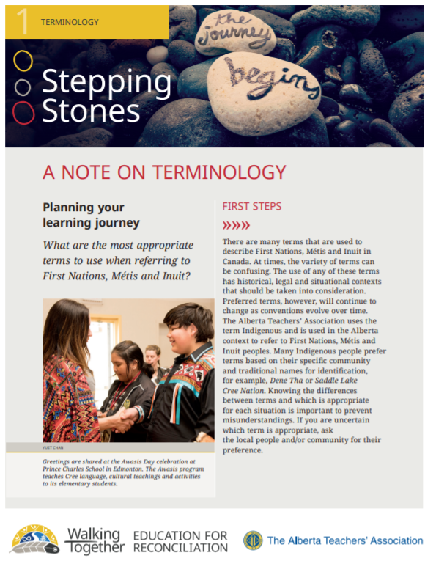
Avoid the Acronym
www.teachers.ab.ca/SiteCollectionDocuments/ATA/For%20Members/ProfessionalDevelopment/Walking%20Together/PD-WT-16a%20-%20Terminology.pdf

Slide 22
Deconstructing the TQS
Community
Personal
School
Classroom

Slide 23
Acknowledgement

Slide 24
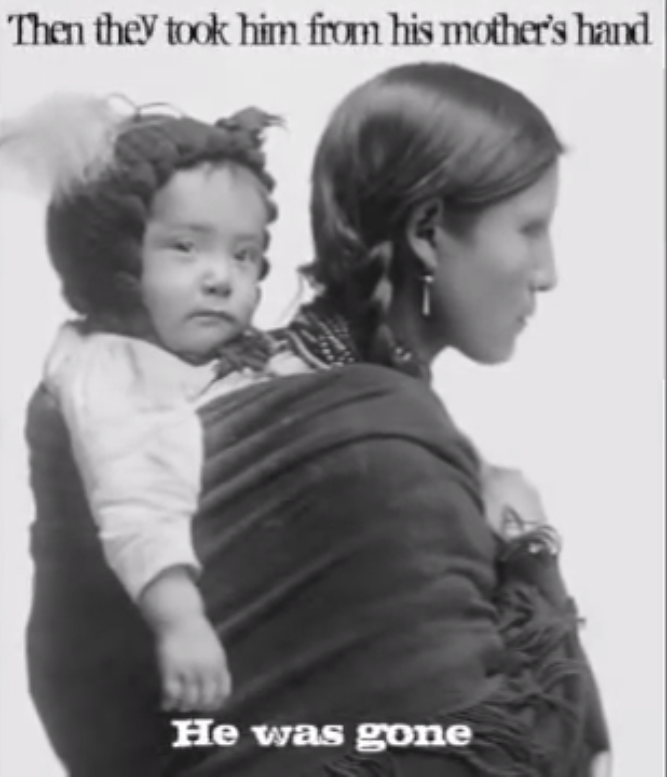
Legacy of Residential Schools
He Can Fancy Dance by Cindy Paul
https://youtu.be/hi_8MB1Gn5c

Slide 25
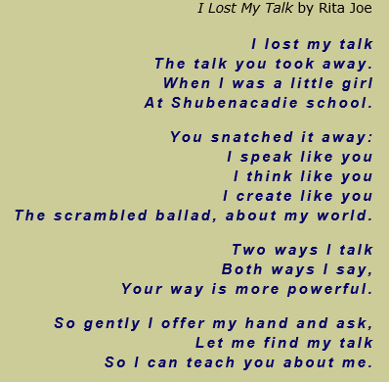
Legacy of Residential Schools
www.historymuseum.ca/cmc/exhibitions/aborig/fp/fpz4c03e.shtml

Slide 26
Concepts of Assimiliation
ASSIMILATION | The process of absorbing one cultural group into another. This can be pursued through harsh and extreme state policies, such as removing children from their families and placing them in the homes or institutions of another culture. Forcing a people to assimilate through legislation is cultural genocide; the intent is to make a culture disappear.
COLONIZATION | A process of gaining control of land and resources. It involves one group of people, the colonizers, coming into an area and dominating the people who are already living there.
CULTURAL GENOCIDE | The destruction of those structures and practices that allow the group to continue as a group. The political and social institutions of the targeted group are set to be destroyed. Land is seized, populations are forcibly transferred and their movement is restricted. Languages are banned. Spiritual leaders are persecuted, spiritual practices are forbidden and objects of spiritual value are confiscated and destroyed. Families are disrupted to prevent the transmission of cultural values and identity from one generation to the next.
BRITISH NORTH AMERICA ACT | Also known as the Constitution Act, 1867, it put ‘Indians and lands reserved for Indians’ under the control of the federal government. When this occurred, Indigenous peoples in Canada lost their rights and were no longer recognized as having control over their lands.

Slide 27
Concepts of Assimiliation
DECOLONIZATION | A process that Indigenous people, impacted by colonization and forced assimilation, might go through by reclaiming, rediscovering and repatriating their Indigenous ways of knowing and being.
EUROCENTRISM | A focus on Europe and Europeans. The idea that Europeans are the central and most important culture in the entire world (politically, religiously, economically, socially).
GRADUAL CIVILIZATION ACT | A bill passed by the 5th Parliament of the Province of Canada in 1857. Required male Indians and Métis over the age of 21 to read, write and speak either English or French and to choose an approved surname by which they would be legally recognized. By the application of this act, Indian and Métis males would lose all of their legal rights, as well as any land claims and would become British subjects, though with far fewer rights. It was called ‘enfranchisement’ and was one of the many policies of forced assimilation. Enfranchisement was viewed by the government as a privilege for Aboriginals.
INTERNAL COLONIZATION | When people live in a place that has been colonized, whether they are the original people or a settler who has come from elsewhere, they gradually absorb the colonizers’ ways of acting and thinking. That is why we talk about needing to decolonize ourselves so that all citizens can change their behaviour.

Slide 28
Concepts of Assimiliation
PATERNALISM | A focus on males being the highest authority figure in all aspects of life. A policy and practice of authority figures who restrict freedom of those considered to be below them. Typically framed as if it is in the best interest of those ‘lower’ than them.
THE SIXTIES SCOOP | From the 1960s to the 1980s, thousands of First Nations and Métis children were forced illegally by the provincial governments from their homes and adopted or fostered, usually by non-Indigenous people. Many of these children experienced violence, racism and abuse and lost connection to their identity and culture. Like residential schools, the purpose was assimilation.
DOCTRINE OF DISCOVERY | In what we now call North America, Europeans made deals amongst themselves and divided up control over Indigenous peoples and Indigenous lands. Usually, whichever European nation ‘discovered’ the land first took control, with the blessing of the Christian church.

Slide 29
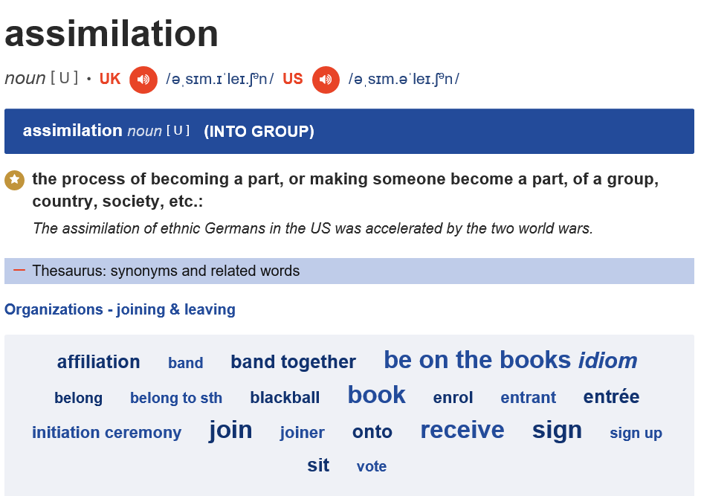
Assimiliation Case Study
https://dictionary.cambridge.org/dictionary/english/assimilation

Slide 30
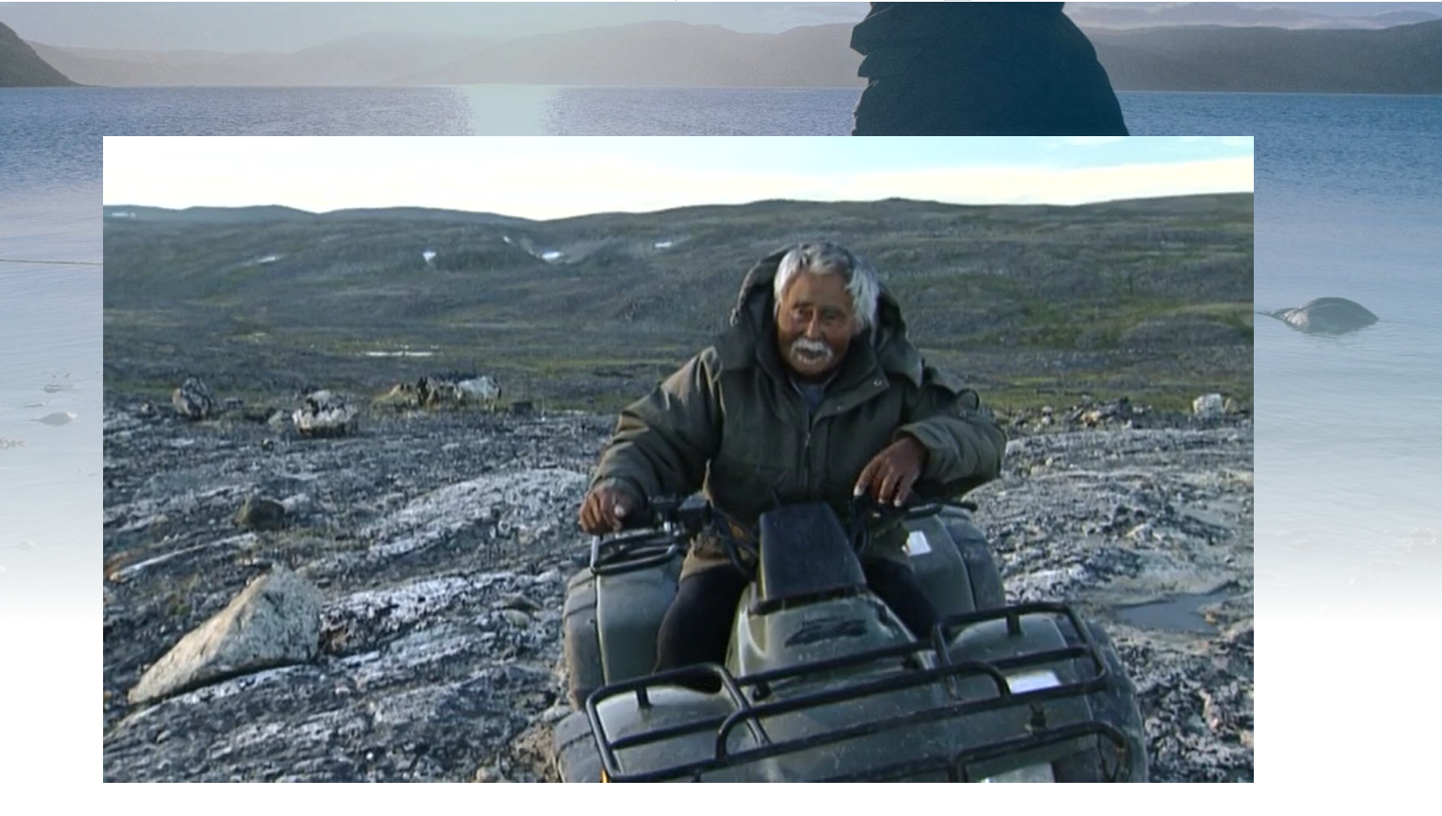
Assimiliation Case Study
www.nfb.ca/film/if_the_weather_permits

Slide 31
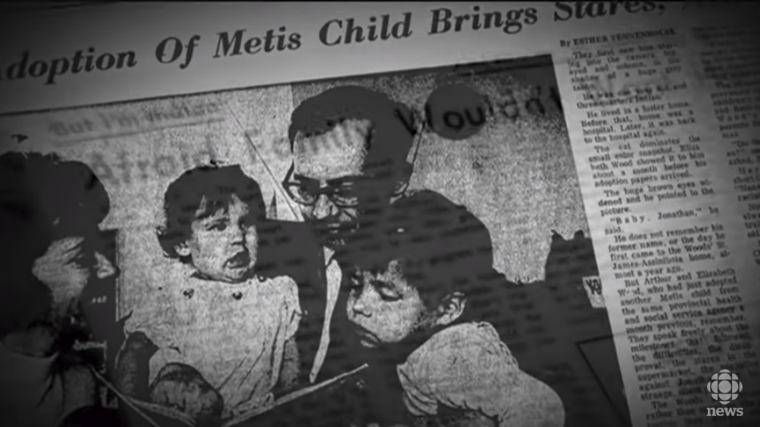
The Sixties Scoop
https://youtu.be/2RZ1yl0FnMs

Slide 32
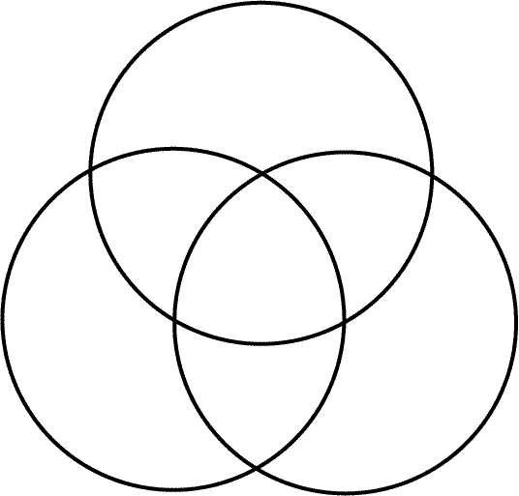
The Sixties Scoop
Impacts on Child
Impacts on Family
Impacts on Community

Slide 33
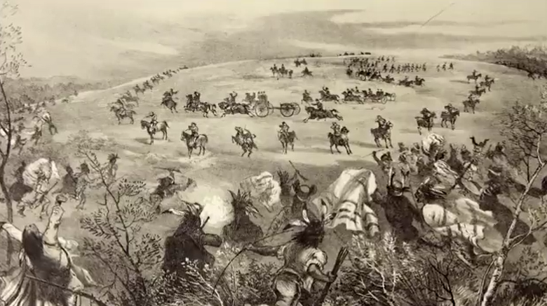
The Pass System
http://aptnnews.ca/2016/04/14/the-pass-system-illegal-confinement-of-rebel-indians-infocus

Slide 34
The Pass System
https://youtu.be/nl3P-4zBTUM

Slide 35
Atonement

Slide 36
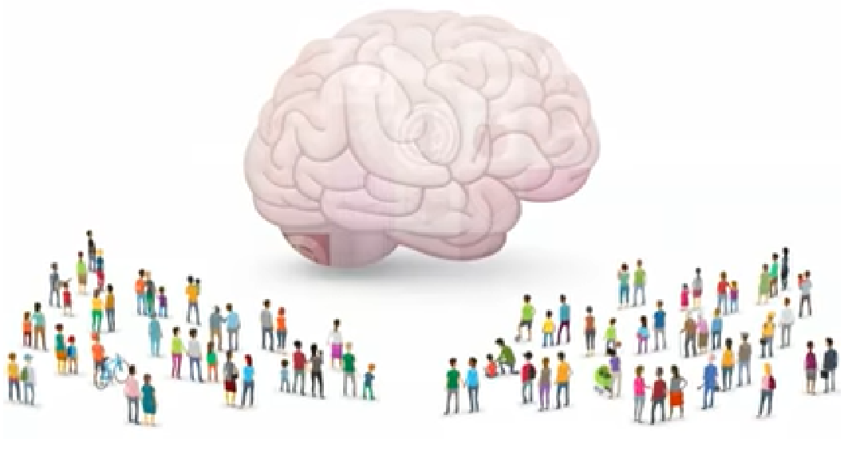
Intergenerational Trauma, Toxic Stress and Development
https://youtu.be/vMseNYpOQvE

Slide 37
Intergenerational Trauma, Toxic Stress and Development
Positive Stress
Healthy for development
Helps prepare children for larger challenges
Tolerable Stress
Supports are in place to help manage stress response
Will not have long-term negative effects on brain development
Toxic Stress
Prolonged, negative stress without supports in place
Increases risk for later physical and mental health problems

Slide 38
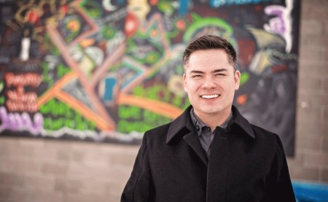
Indigenous Resilience and Success
Aaron Paquette
www.aaronpaquette.net/?page_id=2

Slide 39
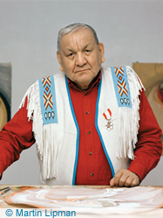
Indigenous Resilience and Success
Alex Janvier
www.alexjanvier.com/aa1.html

Slide 40
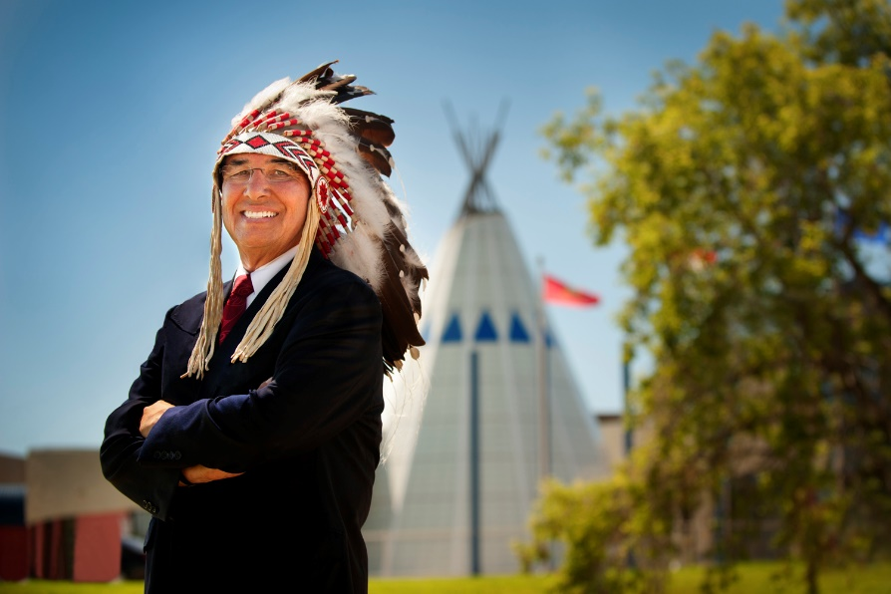
Indigenous Resilience and Success
Dr. Wilton Littlechild
www.lieutenantgovernor.ab.ca/aoe/athletics/willie-littlechild/index.html

Slide 41
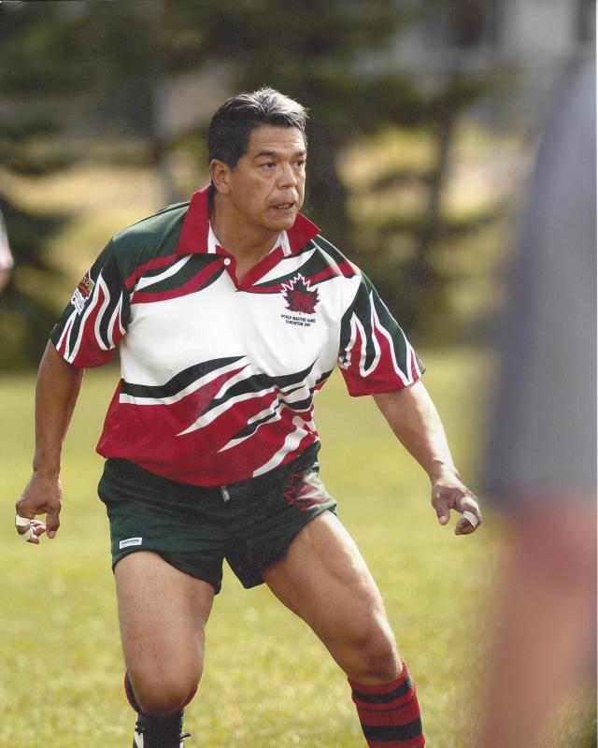
Indigenous Resilience and Success
Lorne Cardinal
https://lornecardinal.wordpress.com/about/dog-river-howlers-rugby

Slide 42
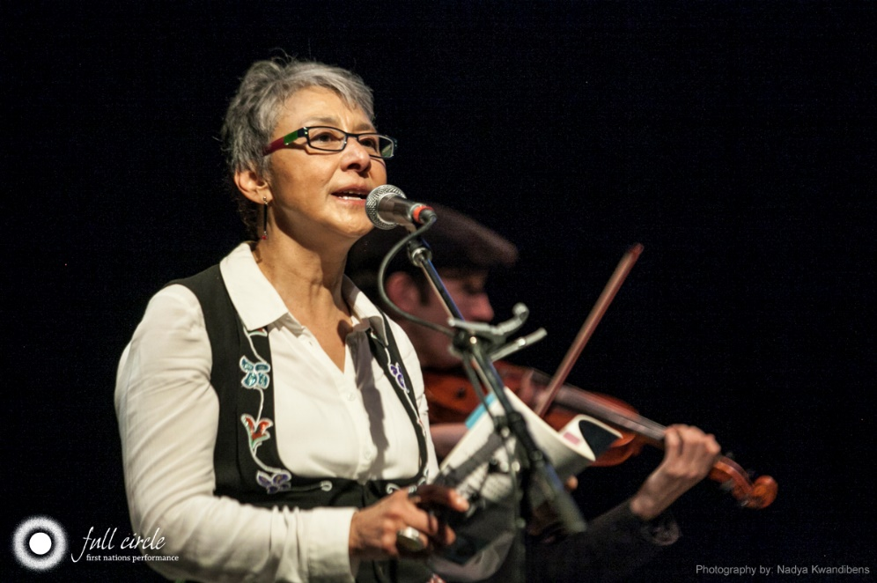
Indigenous Resilience and Success
Marilyn Dumont
www.ualberta.ca/native-studies/about-us/contact-us-people/faculty/marilyn-dumont

Slide 43
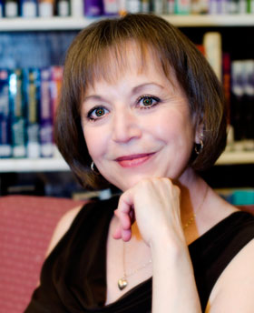
Indigenous Resilience and Success
Jacqueline Guest
www.jacquelineguest.com/about-jacqueline

Slide 44
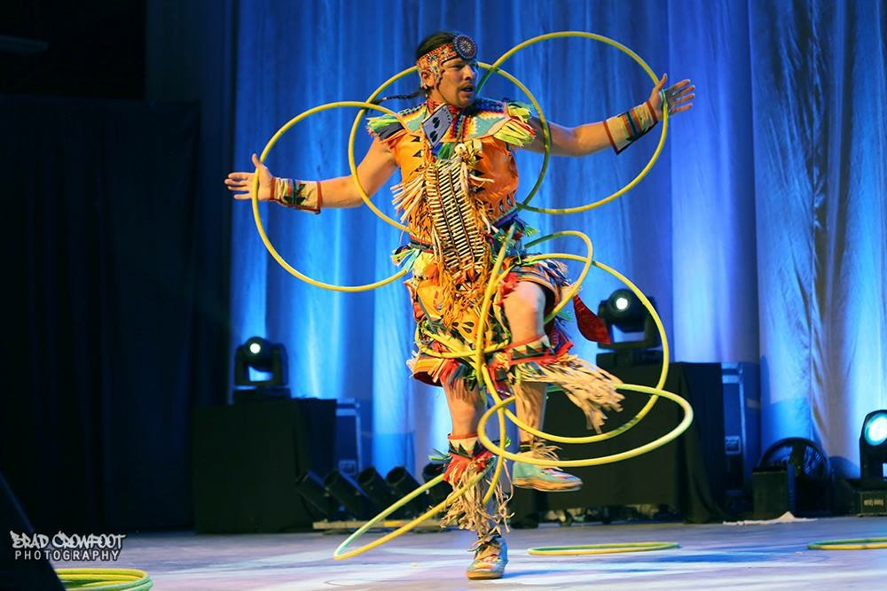
Indigenous Resilience and Success
Dallas Arcand
www.dallasarcand.ca/about

Slide 45
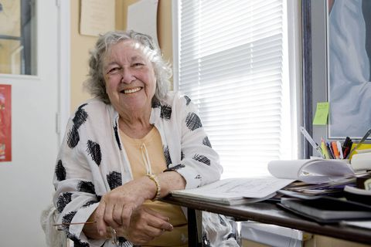
Indigenous Resilience and Success
Thelma Chalifoux
www.theglobeandmail.com/news/politics/thelma-chalifoux-was-the-first-Métis-woman-to-serve-in-canadas-senate/article36520657

Slide 46
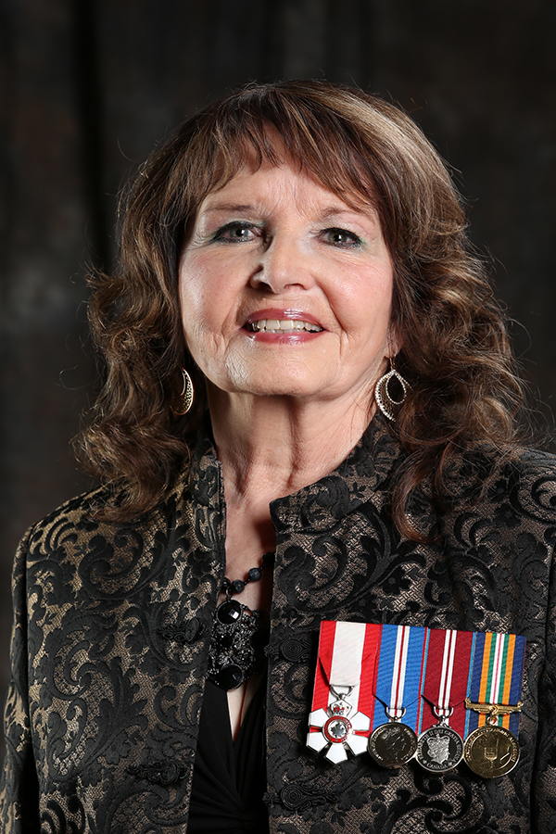
Indigenous Resilience and Success
Muriel Stanley-Venne
http://www.iaaw.ca/

Slide 47
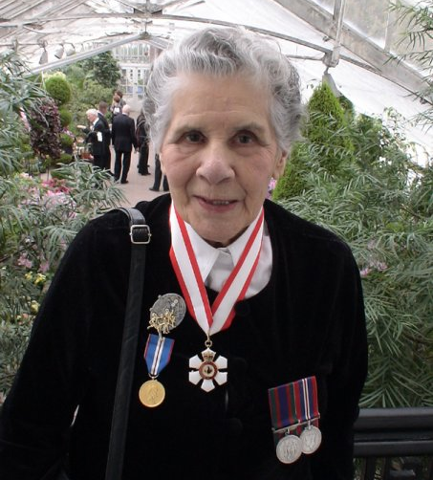
Indigenous Resilience and Success
Bertha Clark (Houle)
https://indspire.ca/laureate/bertha-clark-jones-2/
https://www.nwac.ca/wp-content/uploads/2015/05/12.10.23-NWAC-Remembers-Bertha-Clarke-Jones.pdf

Slide 48
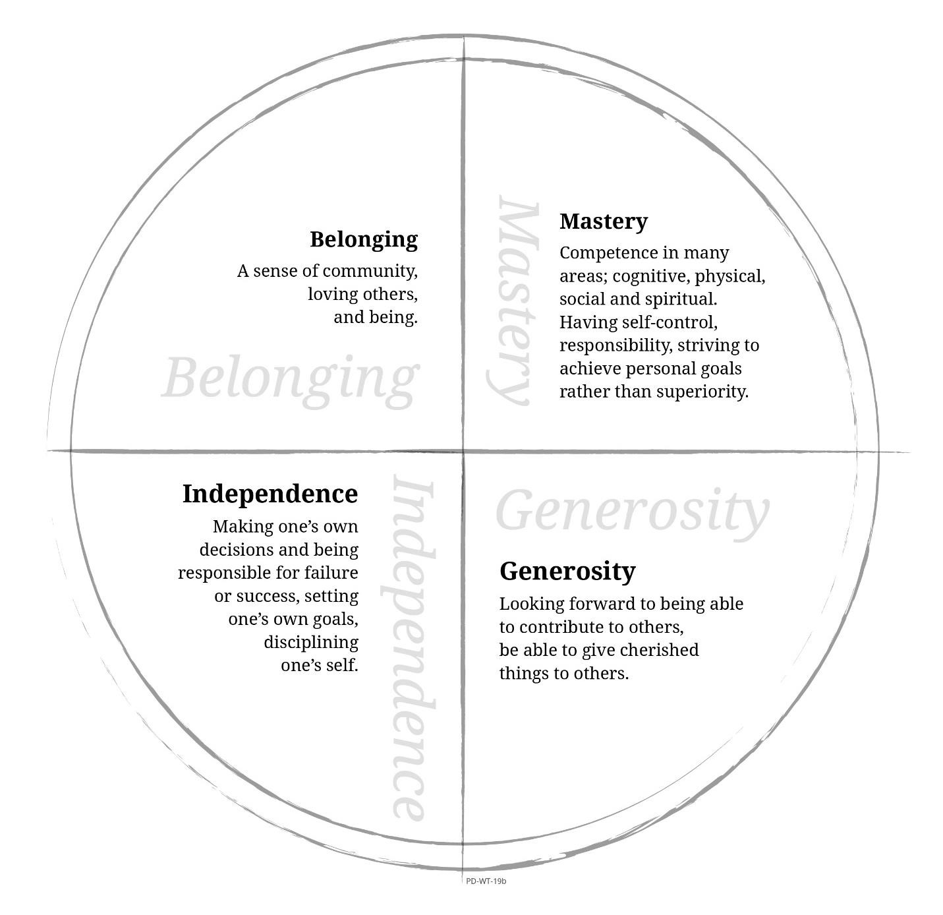
School Reflection—Circle of Courage®

Slide 49
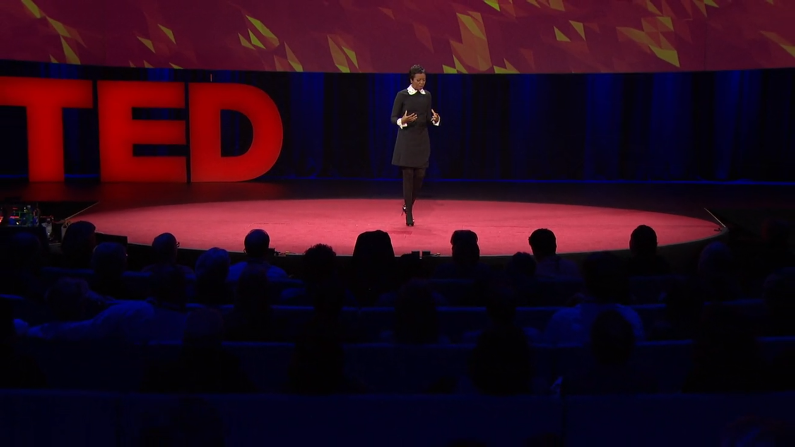
Colour Blind or Colour Brave?
www.ted.com/talks/mellody_hobson_color_blind_or_color_brave

Slide 50
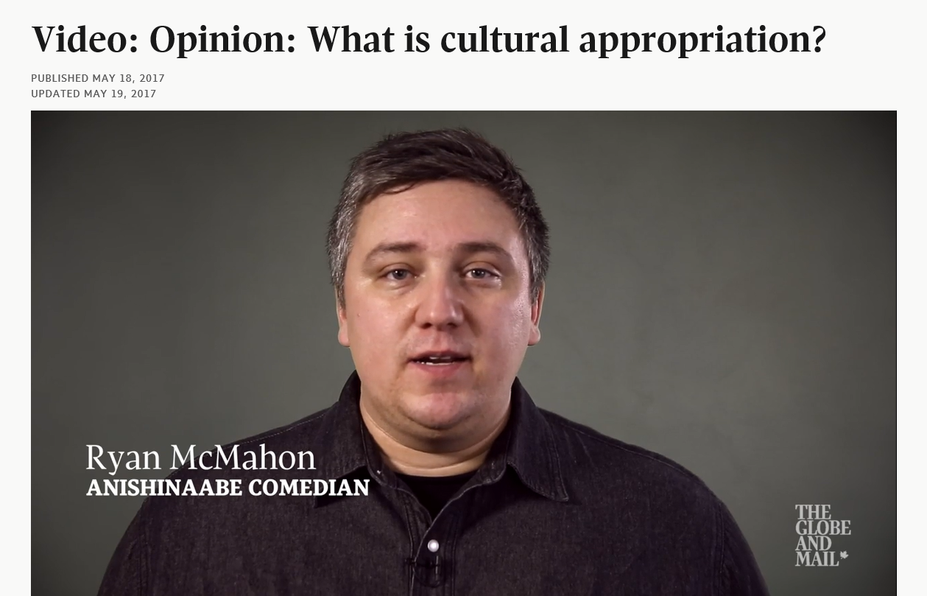
Cultural Appropriation
www.theglobeandmail.com/opinion/video-opinion-what-is-cultural-appropriation/video09e64772-8783-474e-b7a2-ad85871cb120/

Slide 51
Cultural Appropriation
“Taking intellectual property, traditional knowledge, cultural expressions, or artifacts from someone else's culture without permission. This can include unauthorized use of another culture's dance, dress, music, language, folklore, cuisine, traditional medicine, religious symbols, etc. It's most likely to be harmful when the source community is a ​minority group that has been oppressed or exploited in other ways or when the object of appropriation is particularly sensitive, e.g. sacred objects.”
Susan Scafidi, Law Professor
Fordham University
www.thoughtco.com/cultural-appropriation-and-why-iits-wrong-2834561

Slide 52
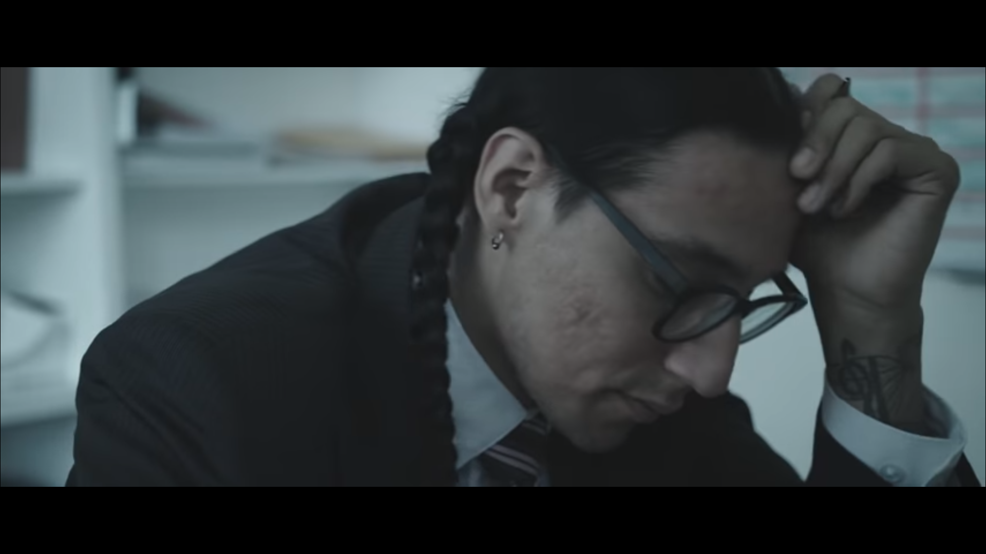
Cultural Revitalization
What does the title “Indomitable” mean?
What does this video say about walking in two worlds?
How does your school community celebrate Indigenous students who walk in two worlds?
https://youtu.be/qTJvpfkRRdA

Slide 53
Action

Slide 54
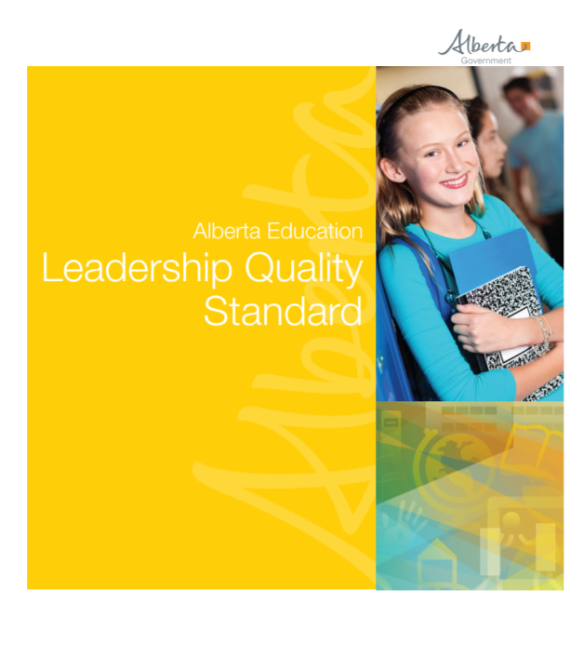
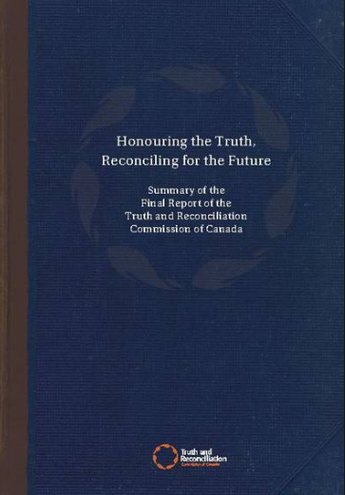
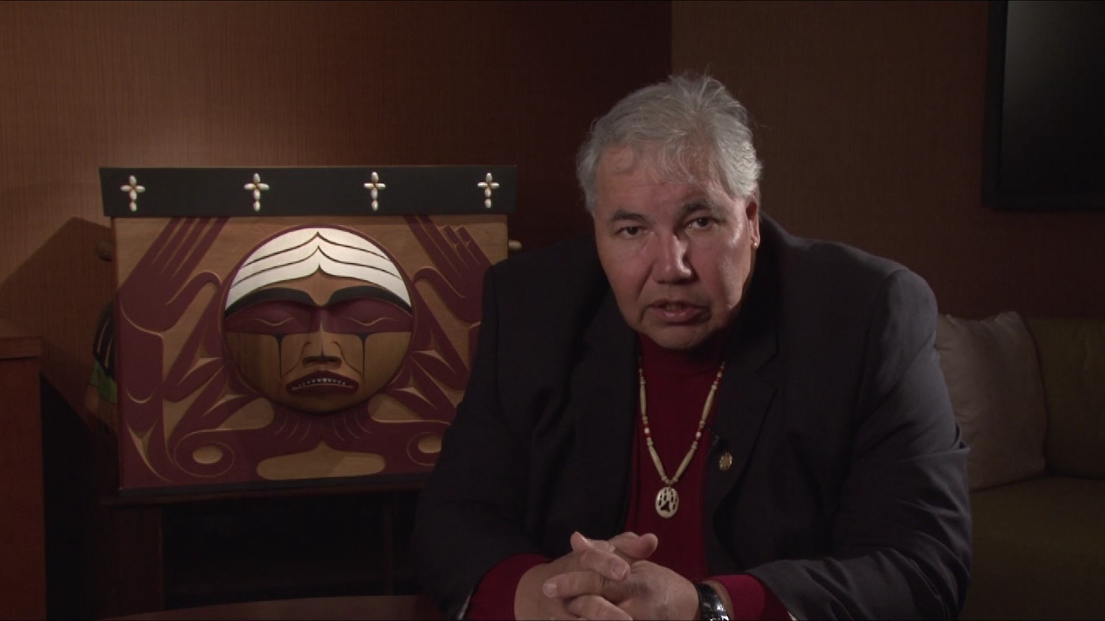
What is Reconciliation?

Slide 55
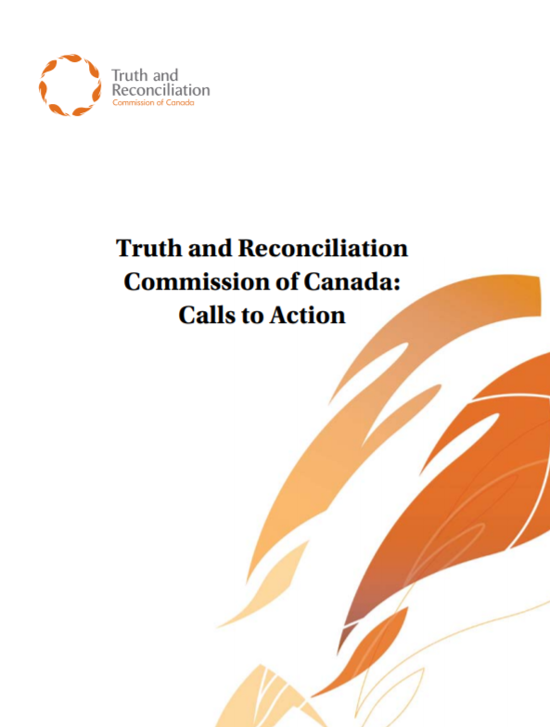
Calls to Action
Which of the selected Calls to Action is most meaningful to you?
How can this Call to Action be implemented within your school community?

Slide 56
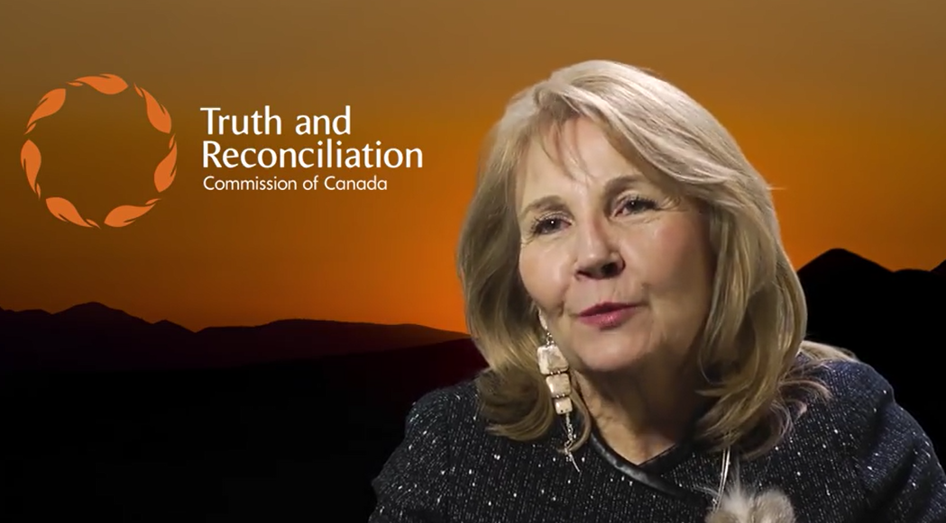
What the TRC Means for All Canadians
https://youtu.be/244Nf0CSqEY

Slide 57
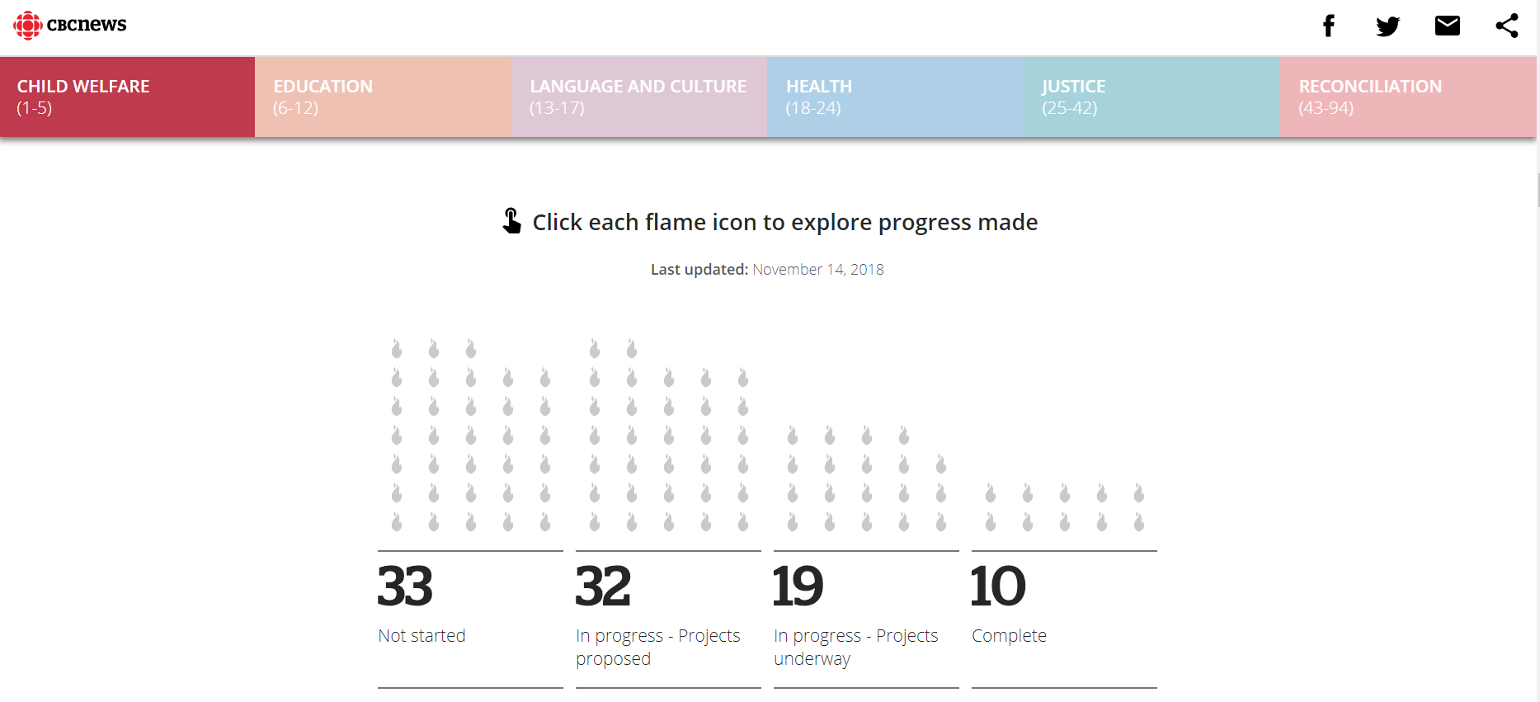
Examing Progress on the 94 Calls to Action

Slide 58
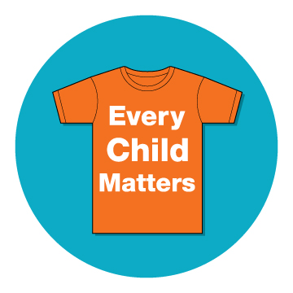
Examing Reconciliation Initiatives: Orange Shirt Day
www.orangeshirtday.org

Slide 59
Examing Reconciliation Initiatives: We Matter
https://wemattercampaign.org

Slide 60
Examing Reconciliation Initiatives: Imagine a Canada
https://nctr.ca/imagineacanada

Slide 61
Examing Reconciliation Initiatives: Honouring Memories, Planting Dreams
https://fncaringsociety.com/honouring-memories-planting-dreams

Slide 62
Examing Reconciliation Initiatives: Project of Heart
“Project of Heart is an inquiry based, hands-on, collaborative, inter-generational, artistic journey of seeking truth about the history of Aboriginal people in Canada.”
http://projectofheart.ca

Slide 63
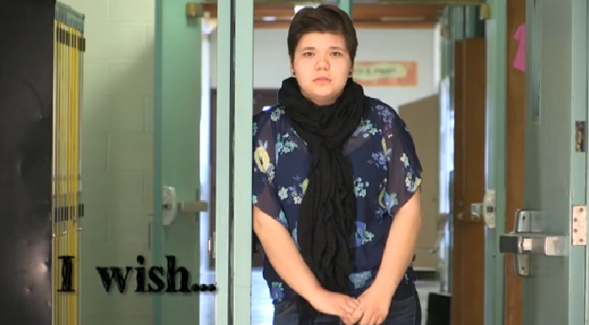
Examing Reconciliation Initiatives: Project of Heart
http://projectofheart.ca/filmsvideos

Slide 64
Reconciliation and Education
https://youtu.be/fu0aIw1vdiE

Slide 65
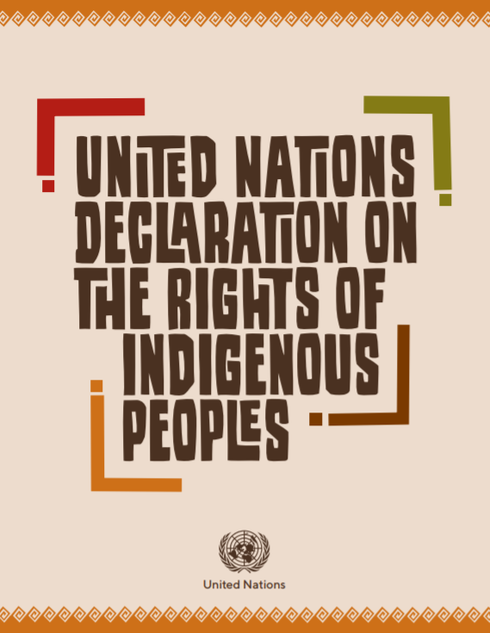
Exploring UNDRIP
Notes:
https://www.un.org/development/desa/indigenouspeoples/wp-content/uploads/sites/19/2018/11/UNDRIP_E_web.pdf

Slide 66
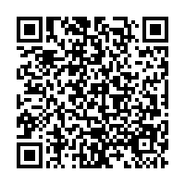
Continue the Conversation…
@walkingtogetherata
@ATAindigenous
https://tinyurl.com/yb9wukun

